Slide 2
Announcements
Homework 0 is due Wednesday 1/14, 11:59pm
  HW0-C: Review problems on probability, linear algebra, and calculus
  HW0-P: Programming - Setup group, github, and starter problem
    Try to have unique group name
    Make sure your Coursys group name and your GitHub repo name match
    Avoid strange characters in your group name

Slide 3
Announcements
Homework 0 is due Wednesday 1/14 (today), 11:59pm
  HW0-C: Individual - please do it by yourself
    Submit to crowdmark
  HW0-P: In groups
    Submit code and output to Coursys
Homework 1 will be out later today, and due in 2 weeks (1/28)

Slide 4
Announcements
  Note that for Programming Assignments (HW#-P) there will be default of 2 grace days
    However, you must have submitted something by the initial due date
    This does not apply for the HW#-C component

Slide 5
Announcements
Homework 1 is out — due 1/28, 11:59pm
  Covers language modeling, text classification (NB, LR, FFN) and evaluation
  Programming - Contextual Spell Checking
    Try to have a group!
    Your report will be graded for its writing and presentation
    Provide comparisons and examples

Slide 6
Announcements
Gradescope - we got a trial
  We will use Gradescope for the project reports
  May use for homework as well
    Allows for regrade requests!

Slide 7
Today
Review
  Language modelling
  Classification with Naive Bayes
Logistic Regression
Neural Networks

Slide 8
Announcements
HW1 is due Wednesday 1/28, by 11:59pm!
  Note that for Programming Assignments (HW#-P) there will be default of 2 grace days
  However, you must have submitted something by the initial due date
  This does not apply for the HW#-C component

Slide 9
Announcements
HW1 is due Wednesday 1/28, by 11:59pm!
  Note that for Programming Assignments (HW#-P) there will be default of 2 grace days
  However, you must have submitted something by the initial due date
  This does not apply for the HW#-C component
HW0 grades available on Gradescope / Coursys

Slide 10
Announcements
Interactive Tutorial Session
  Wednesday 1:00pm to 1:30pm - text classification with word embeddings using pytorch
  Videos will be out tonight
    Text classifications with word embeddings
    Brief review of optimizers

Slide 11
Announcements
Additional video lectures on classification (out tonight)
  Generalization
  Summary of classification
No class next Monday October 10/11
  Will provide lecture recordings from last year

Slide 12
Today
Review
  Logistic Regression
  Neural Networks
Word Vectors

Slide 13
Announcements
HW2 is due Wednesday 2/14, by 11:59pm!
  Note that for Programming Assignments (HW#-P) there will be default of 2 grace days
  However, you must have submitted something by the initial due date
  This does not apply for the HW#-C component
HW1 grades will be out later this week

Slide 14
Announcements
Interactive Tutorial Session
  Wednesday 1:00pm to 1:30pm - FFN for neural language models using pytorch
  Video will be out tonight

Slide 15
Today
Review of Word Vectors
Project Proposal
Maybe sequence modelling?

Slide 16
Recorded lectures
Lecture recordings on Word Vectors
  Word Vectors I (55 min)
    Brief history of neural networks and importance of word vectors
    What are word vectors and how to learn them from context via counting
    TF-IDF
    PPMI
  Word Vectors II (1hr 19 min)
    How to learn word vectors by training classifiers
      Word2vec SkipGram model
    Evaluation
    Application of word vectors to studying word change over time

Slide 17
Recorded lectures
Additional (optional) video lectures
  Words and Senses (28 min):
    Words vs Senses
    What relationships do senses have?
    Categorization and ontologies
  Word Embeddings Summary (46 min):
    Summarizes Word2Vec, a bit more on GloVe
    How to get dense vectors from SVD (also covered in WVI),
    More details on the relationship between PPMI for co-occurrence matrix and GloVe/Skipgram,
    Some extensions to static word embeddings

Slide 18

Project information
CMPT 413/713: Natural Language Processing
Spring 2026
2026-02-11

Slide 19
Summary of topics
So far
  Language Modeling: $P(w_{i}|w_{1:i-1})$
  Text classification: $P(c|d)$
    with Naive Bayes, Logistic Regression and Neural Networks
  Static and contextual word embeddings: Representing $w$ as a vector
  Sequence modeling with RNNs and Transformers
After the break
  Focus on project
  More on pretraining and fine-tuning LLMs
  Structured representations and parsing
  Other NLP applications and using LLMs

Slide 20
HW1-P notebook notes
Talk about how/why your method works in totality (and alternatives), not the step-by-step of when you implemented each part.
  We should be able to reasonably reimplement your method based on the report, without code blocks
Have a dedicated section for experiments/results. If your results (quant. and qual.) are embedded into your method description, it is hard to find and compare different methods.
Explain how your method works and cite sources appropriately, especially if you use an existing library or method for a key part of your implementation.
  E.g. if you used “SequenceMatcher,” you need to cite it and explain how it works at a high level
Qualitative examples should demonstrate your method’s output. Use them not just to illustrate the problem but also to demonstrate actual outputs of your method, including its strengths and failure cases.
Contributions need to be specific. Contributions should demonstrate that you made a tangible contribution to the final solution and report.
  E.g. instead of “explored solutions,” say something like “implemented ABC algorithm” or “tried to find a solution to improve XYZ failure cases”
  Pair programming is fine if you both affirm what you jointly developed
Remove the boilerplate template text from your report.

Slide 21
Project
Project timeline
  2-18 - Initial abstract/title (not graded) for initial feedback
  2-23 - Proposal due
  3-19 - Project milestone due
  4-6 - Final project videos
  4-9 - Final project report due

Slide 22
Project Abstract and Proposal
Initial title and abstract (~250 words)
  Think about what you want to do for your project
  Have an informative title (“CMPT 413 class project” is not a good title)
  Describe the topic/problem your group will work on
  Scope of the project
  Data and compute resources you plan to use
Proposal (1-2 pages)
https://angelxuanchang.github.io/nlp-class/project.html

Slide 23
Project Proposal
What will you work on and why is it interesting?
  What task are you addressing? What is the input / output? Why is it interesting?
  What specific aspects will your project be on?
    Re-implement paper? Compare different methods? Analysis?
  What data do you plan to use? For training vs for evaluation?
    Preliminary statistics for your data (number of sentences, tokens, etc)
  What is the specific method or methods you will use to address the task?
    What will you implement by yourself vs what existing code will you use?
    What compute resources do you plan to use?

Slide 24
Project Proposal
How will you evaluate, and coming up with a plan.
  How do you plan to evaluate?
    Data splits?
    What metrics?
    What experiments will you run to compare different variations / different approaches?
  Timeline and work breakdown
    What do you plan to have by the milestone? The end of the term?
    Who will work on what?

Slide 25
What kind of approaches you want to take
In this class, we started with fundamentals and simple ML models (Naive Bayes and Logistic regression)
You should be experimenting with methods beyond that
  Use pretrained models! Do fine-tuning!
  Use LLMs with few-shot prompting
  We will cover more about these topics after the break
Evaluating LLM capabilities
Adversarial attacks
Model distillation

Slide 26
Type of problem and resources
https://angelxuanchang.github.io/nlp-class/project.html
Pick a problem based on what are you interested in?
Types of problems
  Building a cool NLP application
  Re-implementing / re-reproducing a recent paper
  Applying an existing neural model to a new task
  Implementing a complex neural architecture
  Proposing a new neural model or a new variation of an existing model
  Proposing a new training, optimization, or evaluation scheme
  Experimental and/or theoretical analysis of a NLP model
  Probing the capabilities of current NLP models

Slide 27
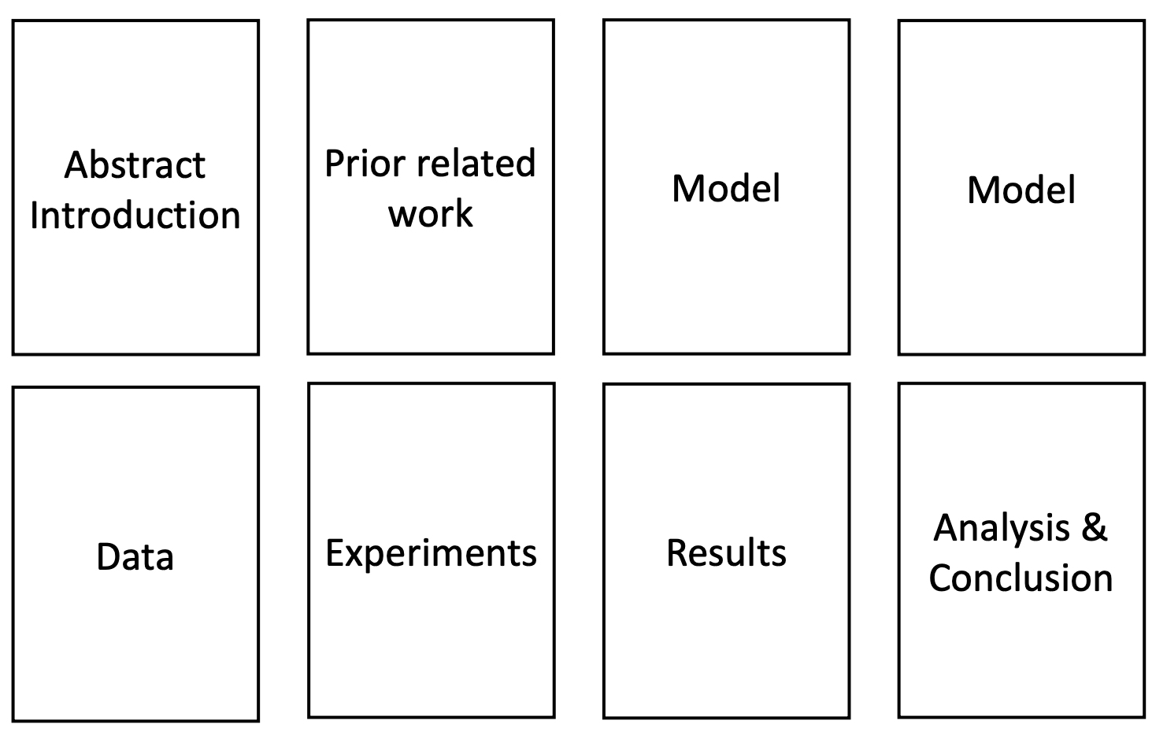
Final project report
8 pages not including references
Model or what approach you are taking
Title
Rough page layout: your report can have different number of pages for each section

Slide 28
What is expected to be included in the project proposal
We expect you to have around 1-2 pages (can be more)
Some preliminary idea of the approach you will take
Data that you will use,
Maybe show examples!
Consider what metrics you will use and methods you will compare against
Include References

Slide 29
Be careful if you try to use LLMs to help you with your abstract!

Slide 30
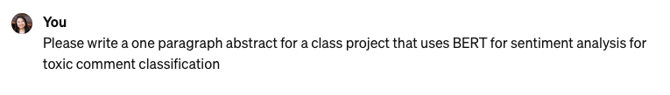

Using ChatGPT for abstract writing
(Spring 2025)
Title: BERT-Enhanced Sentiment Analysis for Toxic Comment Classification: A Comprehensive Investigation
Abstract:
This class project delves into the realm of toxic comment classification using Bidirectional Encoder Representations from Transformers (BERT), an advanced natural language processing model. Toxic comments pose significant challenges in online discourse, necessitating robust sentiment analysis tools for content moderation. The project begins by elucidating the theoretical underpinnings of BERT and its capacity for capturing contextualized word embeddings. We focus on the specific application of toxic comment classification, addressing preprocessing steps, dataset selection, and domain-specific challenges associated with online language. Evaluation metrics such as accuracy, precision, recall, and F1 score are employed to assess the effectiveness of BERT in identifying and categorizing toxic comments. Additionally, the interpretability of the model is explored through attention mechanisms, shedding light on key linguistic indicators of toxicity. The project aims to provide insights into the application of BERT for enhancing content moderation efforts, ultimately contributing to a safer and more inclusive online environment.

Slide 31
Using ChatGPT for abstract writing
Title: BERT-Enhanced Sentiment Analysis for Toxic Comment Classification: A Comprehensive Investigation
Abstract:
This class project delves into the realm of toxic comment classification using Bidirectional Encoder Representations from Transformers (BERT), an advanced natural language processing model. Toxic comments pose significant challenges in online discourse, necessitating robust sentiment analysis tools for content moderation. The project begins by elucidating the theoretical underpinnings of BERT and its capacity for capturing contextualized word embeddings. We focus on the specific application of toxic comment classification, addressing preprocessing steps, dataset selection, and domain-specific challenges associated with online language. Evaluation metrics such as accuracy, precision, recall, and F1 score are employed to assess the effectiveness of BERT in identifying and categorizing toxic comments. Additionally, the interpretability of the model is explored through attention mechanisms, shedding light on key linguistic indicators of toxicity. The project aims to provide insights into the application of BERT for enhancing content moderation efforts, ultimately contributing to a safer and more inclusive online environment.

Slide 32
Using ChatGPT for abstract writing
Title: BERT-Enhanced Sentiment Analysis for Toxic Comment Classification: A Comprehensive Investigation
Abstract:
This class project delves into the realm of toxic comment classification using Bidirectional Encoder Representations from Transformers (BERT), an advanced natural language processing model. Toxic comments pose significant challenges in online discourse, necessitating robust sentiment analysis tools for content moderation. The project begins by elucidating the theoretical underpinnings of BERT and its capacity for capturing contextualized word embeddings. We focus on the specific application of toxic comment classification, addressing preprocessing steps, dataset selection, and domain-specific challenges associated with online language. Evaluation metrics such as accuracy, precision, recall, and F1 score are employed to assess the effectiveness of BERT in identifying and categorizing toxic comments. Additionally, the interpretability of the model is explored through attention mechanisms, shedding light on key linguistic indicators of toxicity. The project aims to provide insights into the application of BERT for enhancing content moderation efforts, ultimately contributing to a safer and more inclusive online environment.
Vague and not informative

Slide 33
Using ChatGPT for abstract writing
Title: BERT-Enhanced Sentiment Analysis for Toxic Comment Classification: A Comprehensive Investigation
Abstract:
This class project delves into the realm of toxic comment classification using Bidirectional Encoder Representations from Transformers (BERT), an advanced natural language processing model. Toxic comments pose significant challenges in online discourse, necessitating robust sentiment analysis tools for content moderation. The project begins by elucidating the theoretical underpinnings of BERT and its capacity for capturing contextualized word embeddings. We focus on the specific application of toxic comment classification, addressing preprocessing steps, dataset selection, and domain-specific challenges associated with online language. Evaluation metrics such as accuracy, precision, recall, and F1 score are employed to assess the effectiveness of BERT in identifying and categorizing toxic comments. Additionally, the interpretability of the model is explored through attention mechanisms, shedding light on key linguistic indicators of toxicity. The project aims to provide insights into the application of BERT for enhancing content moderation efforts, ultimately contributing to a safer and more inclusive online environment.
Okay

Slide 34
Using ChatGPT for abstract writing
Title: BERT-Enhanced Sentiment Analysis for Toxic Comment Classification: A Comprehensive Investigation
Abstract:
This class project delves into the realm of toxic comment classification using Bidirectional Encoder Representations from Transformers (BERT), an advanced natural language processing model. Toxic comments pose significant challenges in online discourse, necessitating robust sentiment analysis tools for content moderation. The project begins by elucidating the theoretical underpinnings of BERT and its capacity for capturing contextualized word embeddings. We focus on the specific application of toxic comment classification, addressing preprocessing steps, dataset selection, and domain-specific challenges associated with online language. Evaluation metrics such as accuracy, precision, recall, and F1 score are employed to assess the effectiveness of BERT in identifying and categorizing toxic comments. Additionally, the interpretability of the model is explored through attention mechanisms, shedding light on key linguistic indicators of toxicity. The project aims to provide insights into the application of BERT for enhancing content moderation efforts, ultimately contributing to a safer and more inclusive online environment.
How? What specifically will be done to explore the interpretability of the model?

Slide 35

Using ChatGPT for abstract writing
(Spring 2026)
Title: Context Matters: Toxic Comment Classification with BERT-Based Sentiment Analysis
Abstract: This class project applies BERT-based sentiment analysis to the task of toxic comment classification, aiming to automatically detect harmful language in online text. We fine-tune a pre-trained BERT model on a labeled dataset of user-generated comments to predict toxicity-related categories and compare its performance against simpler baselines such as logistic regression with TF-IDF features. The model is evaluated using standard metrics including accuracy, precision, recall, and F1-score, with additional attention to class imbalance and false positives that may affect moderation outcomes. Our results demonstrate that fine-tuned BERT captures contextual cues and subtle linguistic patterns more effectively than traditional approaches, leading to improved classification performance. This work highlights the potential of transformer-based language models for supporting scalable and reliable content moderation in real-world settings.
Overall better!

Slide 36
Using ChatGPT for abstract writing
(Spring 2026)
Title: Context Matters: Toxic Comment Classification with BERT-Based Sentiment Analysis
Abstract: This class project applies BERT-based sentiment analysis to the task of toxic comment classification, aiming to automatically detect harmful language in online text. We fine-tune a pre-trained BERT model on a labeled dataset of user-generated comments to predict toxicity-related categories and compare its performance against simpler baselines such as logistic regression with TF-IDF features. The model is evaluated using standard metrics including accuracy, precision, recall, and F1-score, with additional attention to class imbalance and false positives that may affect moderation outcomes. Our results demonstrate that fine-tuned BERT captures contextual cues and subtle linguistic patterns more effectively than traditional approaches, leading to improved classification performance. This work highlights the potential of transformer-based language models for supporting scalable and reliable content moderation in real-world settings.
What specific dataset?
What categories?
Maybe these baselines are too simple!
Now there are a lot of different BERT-based models.

Slide 37
How about having LLM suggest some topics to me?

Slide 38

Using ChatGPT for project suggestion
(Spring 2025)
Title: Sentiment Analysis on Social Media Texts
Abstract:
In this Natural Language Processing (NLP) class project, we aim to develop a sentiment analysis model for social media texts. Social media platforms have become a ubiquitous source of information, opinion, and expression. Analyzing the sentiments expressed in these texts can provide valuable insights into public opinion, user satisfaction, and emerging trends.
The project will involve the following key steps:
Data Collection: Gather a diverse dataset from popular social media platforms, containing text data with associated sentiment labels (positive, negative, neutral).
Preprocessing: Clean and preprocess the data to handle challenges such as noise, abbreviations, and special characters. Tokenization, stemming, and lemmatization will be applied to prepare the text for analysis.
Feature Extraction: Utilize techniques like Bag-of-Words, TF-IDF, or word embeddings to represent the textual data in a format suitable for machine learning models.
Model Development: Experiment with different machine learning algorithms such as Naive Bayes, Support Vector Machines, or deep learning approaches like Recurrent Neural Networks (RNNs) and Transformers for sentiment classification.
Evaluation: Assess the model's performance using metrics such as accuracy, precision, recall, and F1 score. Explore the model's ability to generalize to new, unseen data.
Visualization: Create visualizations to illustrate sentiment trends over time or across different topics/categories, providing a comprehensive understanding of the data.
Deployment: Develop a user-friendly interface or integration that allows users to input text and receive sentiment analysis results. This could be a web application, a chatbot, or a simple API.
This project offers hands-on experience in dealing with real-world text data, implementing machine learning models, and addressing the challenges of sentiment analysis in the context of social media. It also provides an opportunity to explore ethical considerations related to sentiment analysis and the responsible use of NLP technologies in social media analytics

Slide 39
Title: Sentiment Analysis on Social Media Texts
Abstract:
In this Natural Language Processing (NLP) class project, we aim to develop a sentiment analysis model for social media texts. Social media platforms have become a ubiquitous source of information, opinion, and expression. Analyzing the sentiments expressed in these texts can provide valuable insights into public opinion, user satisfaction, and emerging trends.
The project will involve the following key steps:
Data Collection: Gather a diverse dataset from popular social media platforms, containing text data with associated sentiment labels (positive, negative, neutral).
Preprocessing: Clean and preprocess the data to handle challenges such as noise, abbreviations, and special characters. Tokenization, stemming, and lemmatization will be applied to prepare the text for analysis.
Feature Extraction: Utilize techniques like Bag-of-Words, TF-IDF, or word embeddings to represent the textual data in a format suitable for machine learning models.
Model Development: Experiment with different machine learning algorithms such as Naive Bayes, Support Vector Machines, or deep learning approaches like Recurrent Neural Networks (RNNs) and Transformers for sentiment classification.
Evaluation: Assess the model's performance using metrics such as accuracy, precision, recall, and F1 score. Explore the model's ability to generalize to new, unseen data.
Visualization: Create visualizations to illustrate sentiment trends over time or across different topics/categories, providing a comprehensive understanding of the data.
Deployment: Develop a user-friendly interface or integration that allows users to input text and receive sentiment analysis results. This could be a web application, a chatbot, or a simple API.
This project offers hands-on experience in dealing with real-world text data, implementing machine learning models, and addressing the challenges of sentiment analysis in the context of social media. It also provides an opportunity to explore ethical considerations related to sentiment analysis and the responsible use of NLP technologies in social media analytics
Too much work: find existing dataset

Slide 40
Title: Sentiment Analysis on Social Media Texts
Abstract:
In this Natural Language Processing (NLP) class project, we aim to develop a sentiment analysis model for social media texts. Social media platforms have become a ubiquitous source of information, opinion, and expression. Analyzing the sentiments expressed in these texts can provide valuable insights into public opinion, user satisfaction, and emerging trends.
The project will involve the following key steps:
Data Collection: Gather a diverse dataset from popular social media platforms, containing text data with associated sentiment labels (positive, negative, neutral).
Preprocessing: Clean and preprocess the data to handle challenges such as noise, abbreviations, and special characters. Tokenization, stemming, and lemmatization will be applied to prepare the text for analysis.
Feature Extraction: Utilize techniques like Bag-of-Words, TF-IDF, or word embeddings to represent the textual data in a format suitable for machine learning models.
Model Development: Experiment with different machine learning algorithms such as Naive Bayes, Support Vector Machines, or deep learning approaches like Recurrent Neural Networks (RNNs) and Transformers for sentiment classification.
Evaluation: Assess the model's performance using metrics such as accuracy, precision, recall, and F1 score. Explore the model's ability to generalize to new, unseen data.
Visualization: Create visualizations to illustrate sentiment trends over time or across different topics/categories, providing a comprehensive understanding of the data.
Deployment: Develop a user-friendly interface or integration that allows users to input text and receive sentiment analysis results. This could be a web application, a chatbot, or a simple API.
This project offers hands-on experience in dealing with real-world text data, implementing machine learning models, and addressing the challenges of sentiment analysis in the context of social media. It also provides an opportunity to explore ethical considerations related to sentiment analysis and the responsible use of NLP technologies in social media analytics
Many of these steps are not necessary if you use existing datasets and modern deep learning techniques. You will need to tokenize.

Slide 41
Title: Sentiment Analysis on Social Media Texts
Abstract:
In this Natural Language Processing (NLP) class project, we aim to develop a sentiment analysis model for social media texts. Social media platforms have become a ubiquitous source of information, opinion, and expression. Analyzing the sentiments expressed in these texts can provide valuable insights into public opinion, user satisfaction, and emerging trends.
The project will involve the following key steps:
Data Collection: Gather a diverse dataset from popular social media platforms, containing text data with associated sentiment labels (positive, negative, neutral).
Preprocessing: Clean and preprocess the data to handle challenges such as noise, abbreviations, and special characters. Tokenization, stemming, and lemmatization will be applied to prepare the text for analysis.
Feature Extraction: Utilize techniques like Bag-of-Words, TF-IDF, or word embeddings to represent the textual data in a format suitable for machine learning models.
Model Development: Experiment with different machine learning algorithms such as Naive Bayes, Support Vector Machines, or deep learning approaches like Recurrent Neural Networks (RNNs) and Transformers for sentiment classification.
Evaluation: Assess the model's performance using metrics such as accuracy, precision, recall, and F1 score. Explore the model's ability to generalize to new, unseen data.
Visualization: Create visualizations to illustrate sentiment trends over time or across different topics/categories, providing a comprehensive understanding of the data.
Deployment: Develop a user-friendly interface or integration that allows users to input text and receive sentiment analysis results. This could be a web application, a chatbot, or a simple API.
This project offers hands-on experience in dealing with real-world text data, implementing machine learning models, and addressing the challenges of sentiment analysis in the context of social media. It also provides an opportunity to explore ethical considerations related to sentiment analysis and the responsible use of NLP technologies in social media analytics
At this point, you should be using word embeddings. But that may also just be part of the deep learning model.

Slide 42
Title: Sentiment Analysis on Social Media Texts
Abstract:
In this Natural Language Processing (NLP) class project, we aim to develop a sentiment analysis model for social media texts. Social media platforms have become a ubiquitous source of information, opinion, and expression. Analyzing the sentiments expressed in these texts can provide valuable insights into public opinion, user satisfaction, and emerging trends.
The project will involve the following key steps:
Data Collection: Gather a diverse dataset from popular social media platforms, containing text data with associated sentiment labels (positive, negative, neutral).
Preprocessing: Clean and preprocess the data to handle challenges such as noise, abbreviations, and special characters. Tokenization, stemming, and lemmatization will be applied to prepare the text for analysis.
Feature Extraction: Utilize techniques like Bag-of-Words, TF-IDF, or word embeddings to represent the textual data in a format suitable for machine learning models.
Model Development: Experiment with different machine learning algorithms such as Naive Bayes, Support Vector Machines, or deep learning approaches like Recurrent Neural Networks (RNNs) and Transformers for sentiment classification.
Evaluation: Assess the model's performance using metrics such as accuracy, precision, recall, and F1 score. Explore the model's ability to generalize to new, unseen data.
Visualization: Create visualizations to illustrate sentiment trends over time or across different topics/categories, providing a comprehensive understanding of the data.
Deployment: Develop a user-friendly interface or integration that allows users to input text and receive sentiment analysis results. This could be a web application, a chatbot, or a simple API.
This project offers hands-on experience in dealing with real-world text data, implementing machine learning models, and addressing the challenges of sentiment analysis in the context of social media. It also provides an opportunity to explore ethical considerations related to sentiment analysis and the responsible use of NLP technologies in social media analytics
You don’t need to implement so many methods. Again, at this point, you should focus on deep learning methods. You pick, but we want the details and specifics of what you are using.

Slide 43
Title: Sentiment Analysis on Social Media Texts
Abstract:
In this Natural Language Processing (NLP) class project, we aim to develop a sentiment analysis model for social media texts. Social media platforms have become a ubiquitous source of information, opinion, and expression. Analyzing the sentiments expressed in these texts can provide valuable insights into public opinion, user satisfaction, and emerging trends.
The project will involve the following key steps:
Data Collection: Gather a diverse dataset from popular social media platforms, containing text data with associated sentiment labels (positive, negative, neutral).
Preprocessing: Clean and preprocess the data to handle challenges such as noise, abbreviations, and special characters. Tokenization, stemming, and lemmatization will be applied to prepare the text for analysis.
Feature Extraction: Utilize techniques like Bag-of-Words, TF-IDF, or word embeddings to represent the textual data in a format suitable for machine learning models.
Model Development: Experiment with different machine learning algorithms such as Naive Bayes, Support Vector Machines, or deep learning approaches like Recurrent Neural Networks (RNNs) and Transformers for sentiment classification.
Evaluation: Assess the model's performance using metrics such as accuracy, precision, recall, and F1 score. Explore the model's ability to generalize to new, unseen data.
Visualization: Create visualizations to illustrate sentiment trends over time or across different topics/categories, providing a comprehensive understanding of the data.
Deployment: Develop a user-friendly interface or integration that allows users to input text and receive sentiment analysis results. This could be a web application, a chatbot, or a simple API.
This project offers hands-on experience in dealing with real-world text data, implementing machine learning models, and addressing the challenges of sentiment analysis in the context of social media. It also provides an opportunity to explore ethical considerations related to sentiment analysis and the responsible use of NLP technologies in social media analytics
This part is important! Pay attention to evaluation

Slide 44
Title: Sentiment Analysis on Social Media Texts
Abstract:
In this Natural Language Processing (NLP) class project, we aim to develop a sentiment analysis model for social media texts. Social media platforms have become a ubiquitous source of information, opinion, and expression. Analyzing the sentiments expressed in these texts can provide valuable insights into public opinion, user satisfaction, and emerging trends.
The project will involve the following key steps:
Data Collection: Gather a diverse dataset from popular social media platforms, containing text data with associated sentiment labels (positive, negative, neutral).
Preprocessing: Clean and preprocess the data to handle challenges such as noise, abbreviations, and special characters. Tokenization, stemming, and lemmatization will be applied to prepare the text for analysis.
Feature Extraction: Utilize techniques like Bag-of-Words, TF-IDF, or word embeddings to represent the textual data in a format suitable for machine learning models.
Model Development: Experiment with different machine learning algorithms such as Naive Bayes, Support Vector Machines, or deep learning approaches like Recurrent Neural Networks (RNNs) and Transformers for sentiment classification.
Evaluation: Assess the model's performance using metrics such as accuracy, precision, recall, and F1 score. Explore the model's ability to generalize to new, unseen data.
Visualization: Create visualizations to illustrate sentiment trends over time or across different topics/categories, providing a comprehensive understanding of the data.
Deployment: Develop a user-friendly interface or integration that allows users to input text and receive sentiment analysis results. This could be a web application, a chatbot, or a simple API.
This project offers hands-on experience in dealing with real-world text data, implementing machine learning models, and addressing the challenges of sentiment analysis in the context of social media. It also provides an opportunity to explore ethical considerations related to sentiment analysis and the responsible use of NLP technologies in social media analytics
Do try to provide qualitative analysis (give examples) and
breakdown of performance

Slide 45
Title: Sentiment Analysis on Social Media Texts
Abstract:
In this Natural Language Processing (NLP) class project, we aim to develop a sentiment analysis model for social media texts. Social media platforms have become a ubiquitous source of information, opinion, and expression. Analyzing the sentiments expressed in these texts can provide valuable insights into public opinion, user satisfaction, and emerging trends.
The project will involve the following key steps:
Data Collection: Gather a diverse dataset from popular social media platforms, containing text data with associated sentiment labels (positive, negative, neutral).
Preprocessing: Clean and preprocess the data to handle challenges such as noise, abbreviations, and special characters. Tokenization, stemming, and lemmatization will be applied to prepare the text for analysis.
Feature Extraction: Utilize techniques like Bag-of-Words, TF-IDF, or word embeddings to represent the textual data in a format suitable for machine learning models.
Model Development: Experiment with different machine learning algorithms such as Naive Bayes, Support Vector Machines, or deep learning approaches like Recurrent Neural Networks (RNNs) and Transformers for sentiment classification.
Evaluation: Assess the model's performance using metrics such as accuracy, precision, recall, and F1 score. Explore the model's ability to generalize to new, unseen data.
Visualization: Create visualizations to illustrate sentiment trends over time or across different topics/categories, providing a comprehensive understanding of the data.
Deployment: Develop a user-friendly interface or integration that allows users to input text and receive sentiment analysis results. This could be a web application, a chatbot, or a simple API.
This project offers hands-on experience in dealing with real-world text data, implementing machine learning models, and addressing the challenges of sentiment analysis in the context of social media. It also provides an opportunity to explore ethical considerations related to sentiment analysis and the responsible use of NLP technologies in social media analytics
Deployment is not necessary for the class project

Slide 46
Using ChatGPT for project suggestion
(Spring 2026)
Here’s a solid NLP project idea that’s interesting, doable, and publishable-ish without requiring a giant lab-scale dataset.
Project idea: Faithful Meeting Summarization with Evidence Linking
Core problem
Most meeting summarizers produce fluent summaries, but they often:
invent decisions (“hallucinate”)
blur who said what
miss action items
fail to cite where information came from
Your project
Build a meeting summarization system that outputs:
a structured summary (decisions, action items, open questions, key points)
evidence links: each summary bullet is linked to the exact supporting utterances in the transcript
Why it’s a good NLP project
Very relevant to real-world use (Zoom/Teams notes)
Evaluatable beyond ROUGE (faithfulness + attribution)
Works nicely with modern LLMs + retrieval + constraints
You can make a strong “systems + evaluation” paper without inventing a new model
Dataset options
AMI Meeting Corpus
ICSI Meeting Corpus
QMSum (query-based, but adaptable)
Evaluation ideas
Evidence precision/recall: does the cited span actually support the claim?
Hallucination rate: unsupported summary statements
Action item extraction F1
Human evaluation: usefulness + trustworthiness
Better but…
Is it interesting to you?
Is it doable by you?
Did it suggest the same idea
to others?
Double check suggested datasets and evaluation metrics
In the end, you need to understand and execute
your project ideas!

Slide 47
Using ChatGPT for project suggestion
(Spring 2026)
Abstract (you can use as a paper-style abstract)
Abstract —
Meeting summarization is a practical application of natural language processing, but existing systems frequently produce summaries that are difficult to trust due to hallucinated content, missing attribution, and incomplete capture of action items. We propose a meeting summarization framework that generates structured summaries consisting of decisions, action items, unresolved questions, and key discussion points, while explicitly linking each summary statement to supporting evidence spans in the transcript. Our approach combines segment-level retrieval with constrained generation to encourage factual grounding and speaker-aware attribution. We introduce an automatic evaluation protocol for faithfulness based on evidence precision and coverage, alongside standard summarization metrics and human judgments of usefulness. Experiments on publicly available meeting corpora demonstrate that evidence-linked summaries reduce unsupported statements and improve user trust compared to baseline summarizers, while maintaining competitive informativeness. This work highlights the importance of grounding and verifiability in summarization systems intended for real-world deployment.
If you want, I can also:
turn this into a full project plan (milestones + experiments)
suggest 2–3 alternative projects in different directions (NLP+vision, NLU+3D grounding, etc.)

Slide 48
Using ChatGPT for project suggestion
(Spring 2026)
Project idea: “Fact-or-Flavor”: Faithful Summarization with Grounded Citations for Web & PDF Sources
One-line pitch: Build a summarization system that produces useful summaries only from evidence it can quote, and attaches sentence-level citations (like a mini literature review, but automated).
Why this is a good NLP project
Most summarizers are fluent but unreliable: they’ll invent details, blur sources, or mix facts across documents. This project tackles a real pain point in research, enterprise, and education: trustworthy summaries.
It’s also nicely scoped: you can start with a simple baseline and keep upgrading.
What you would build
A system that takes:
a set of documents (web pages, PDFs, or papers)
a query or task prompt (e.g., “Summarize the key findings about X”)
And outputs:
a structured summary (bullets + short paragraph)
every sentence backed by citations (document + span)
a “coverage vs hallucination” score
Core NLP components (very doable)
Document chunking + retrieval (BM25 or dense retrieval)
Evidence selection
Citation-aware generation
Automatic evaluation of faithfulness (e.g., entailment / attribution metrics)

Slide 49
Using ChatGPT for project suggestion
(Spring 2026)
Abstract (ready to submit)
Title: Fact-or-Flavor: Citation-Grounded Summarization for Faithful Multi-Document NLP
Abstract:
Neural summarization systems often produce fluent outputs that contain hallucinated or weakly supported claims, limiting their usefulness in high-stakes settings such as scientific review, policy analysis, and enterprise reporting. We present Fact-or-Flavor, a citation-grounded summarization framework that generates multi-document summaries constrained to evidence explicitly retrieved from source texts. Given a query and a collection of documents, the system performs retrieval and evidence selection over semantically coherent text chunks, then produces a structured summary where each sentence is accompanied by one or more citations pointing to the supporting source spans. To evaluate factual consistency, we measure attribution precision using span overlap and entailment-based scoring, and report a coverage metric quantifying how well the summary reflects the document set. Experiments on web and PDF corpora demonstrate that grounding generation in retrieved evidence substantially reduces unsupported claims while maintaining informativeness and readability. This work provides a practical step toward trustworthy summarization systems that are both useful and verifiable.
If you want, I can also:
propose a 4-week project plan,
suggest datasets + evaluation metrics,
or tailor this to a specific domain (scientific papers, news, legal, medical, etc.).

Slide 50
Last year observations on project abstract
Many of the abstract seems to be generated using LLMs
  Good: Fluent English, with nice keywords
  Bad: vague, over-scoped projects
What you DON’T need to include / do:
  Prerequisites - don’t list the prerequisites of the class as prerequisites for your projects
  Address everything - try to scope your project down
  Collect datasets - try to use existing datasets

Slide 51
Examples of what not to have:
“we will be using Natural Language Processing” to …
This entire class is on NLP - at this point, you should be able to be more specific about what model you plan to use

Slide 52
Examples of what not to have:
“The prerequisites for this project are knowledge of mathematics and statistics, machine learning fundamentals, deep learning, NLP, programming and frameworks. Most of the topics are something that at least one of the team members knows about or can easily refresh their knowledge.”
These are very broad prerequisites. Also, you are in this class, you should know this. It shouldn’t be something that needs to be specified.

Slide 53
Examples of what not to have:
Try to avoid dataset collection and data cleaning
Be careful:
  “our healthcare data from WHO and FDA, stock data from Yahoo finance, and market indicators data from S&P500 and BioTech index”
  “decent dataset made up of diverse texts that may include articles, books, and some online content. After that, the data should be cleaned to ensure better quality”
  How long will this take? Try to find existing datasets.
Better: “We will use a Kaggle dataset”
  Be precise: which dataset?
  Also some Kaggle problems are not interesting…

Slide 54
Announcements
Interactive Tutorial Session
  Wednesday 1:00pm to 1:30pm - RNNs for neural language models using pytorch
  Video will be out tonight

Slide 55
Many possible NLP tasks and problems!

Slide 56
Some NLP Tasks
SQuAD: question answering
POS: Part-of-speech tagging
SNLI: natural language inference
Entity linking
SRL: semantic role labeling
Constituency Parsing
Coref: coreference resolution
Dependency Parsing
NER: named entity recognition
Intent detection and slot filling
SST-5: sentiment analysis
Machine translation
Paraphrasing
Summarization
Semantic Parsing (text to code)
Question Answering
Multimodal tasks (e.g. image captioning)

Slide 57
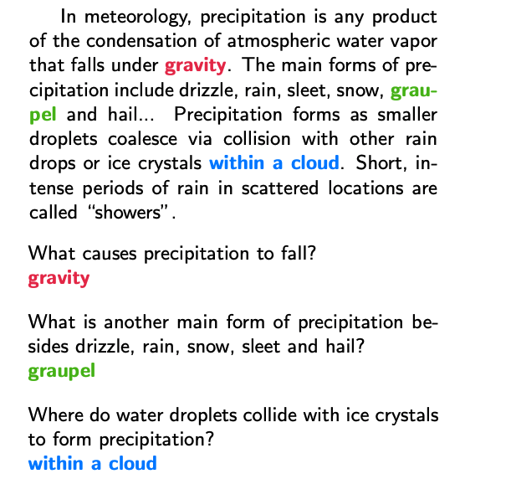
Tasks
Passage
SQuAD: question answering
SNLI: natural language inference
SRL: semantic role labeling
Coref: coreference resolution
NER: named entity recognition
SST-5: sentiment analysis
Question / Answer
Stanford CS224 default project
SQuAD
RobustQA
SQuAD: 100,000+ Questions for Machine Comprehension of Text
Rajpurkar et al, EMNLP 2016

Slide 58
contradiction
Tasks
Premise
Hypothesis
entailment
SQuAD: question answering
neutral
SNLI: natural language inference
A man inspects the uniform of a figure in some East Asian country.
SRL: semantic role labeling
The man is sleeping.
Coref: coreference resolution
NER: named entity recognition
An older and younger man smiling.
SST-5: sentiment analysis
Two men are smiling and laughing at the cats playing on the floor.
A soccer game with multiple males playing.
Some men are playing a sport.
A large annotated corpus for learning natural language inference
Bowman et al, EMNLP 2015

Slide 59
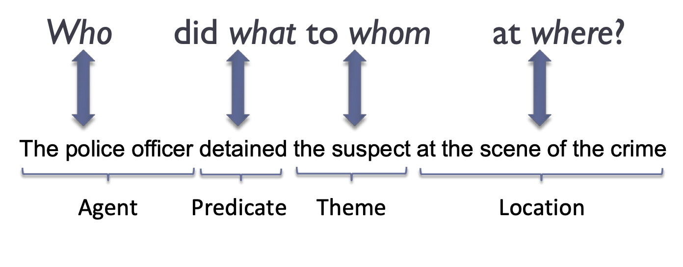
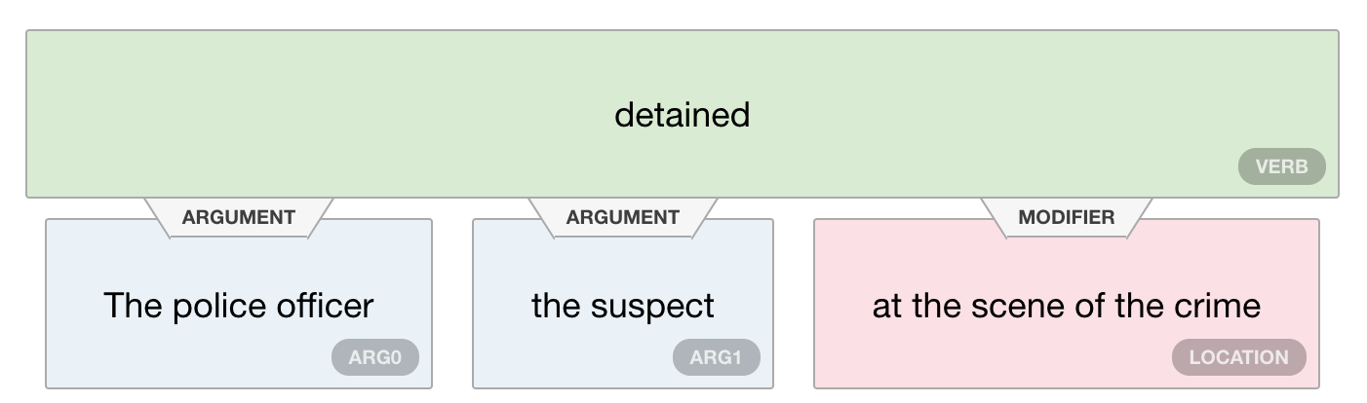
Tasks
SQuAD: question answering
SNLI: natural language inference
SRL: semantic role labeling
Coref: coreference resolution
NER: named entity recognition
SST-5: sentiment analysis
Different types of frames
  FrameNet vs PropBank
Different semantics roles depending on the verb
(figure credit: https://demo.allennlp.org/semantic-role-labeling/)
Automatic Labeling of Semantic Roles
Gildea and Jurafsky, CL 2002
Notes:
Automatic Labeling of Semantic Roles
Gildea and Jurafsky, CL 2002

Slide 60
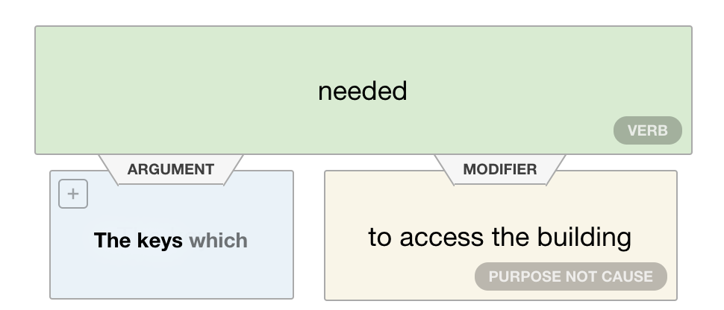
Tasks
The keys, which were needed to access the building, were locked in the car.
SQuAD: question answering
SNLI: natural language inference
SRL: semantic role labeling
Coref: coreference resolution
NER: named entity recognition
SST-5: sentiment analysis
(figure credit: https://demo.allennlp.org/semantic-role-labeling/)
Automatic Labeling of Semantic Roles
Gildea and Jurafsky, CL 2002
Notes:
Automatic Labeling of Semantic Roles
Gildea and Jurafsky, CL 2002

Slide 61
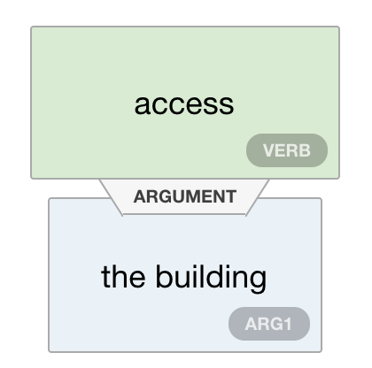
Tasks
The keys, which were needed to access the building, were locked in the car.
SQuAD: question answering
SNLI: natural language inference
SRL: semantic role labeling
Coref: coreference resolution
NER: named entity recognition
SST-5: sentiment analysis
(figure credit: https://demo.allennlp.org/semantic-role-labeling/)
Automatic Labeling of Semantic Roles
Gildea and Jurafsky, CL 2002
Notes:
Automatic Labeling of Semantic Roles
Gildea and Jurafsky, CL 2002

Slide 62
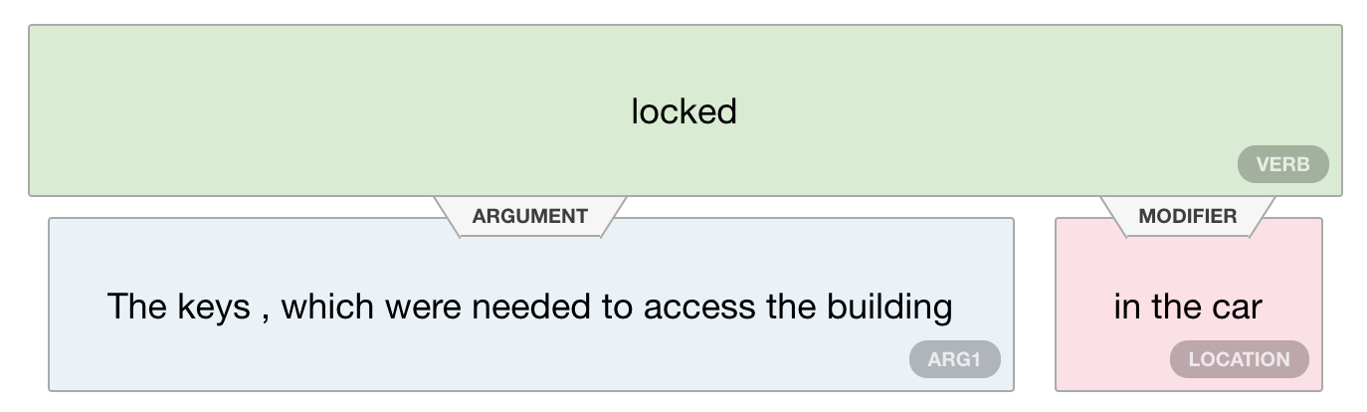
Tasks
The keys, which were needed to access the building, were locked in the car.
SQuAD: question answering
SNLI: natural language inference
SRL: semantic role labeling
Coref: coreference resolution
NER: named entity recognition
SST-5: sentiment analysis
(figure credit: https://demo.allennlp.org/semantic-role-labeling/)
Automatic Labeling of Semantic Roles
Gildea and Jurafsky, CL 2002
Notes:
Automatic Labeling of Semantic Roles
Gildea and Jurafsky, CL 2002

Slide 63
Tasks
SQuAD: question answering
SNLI: natural language inference
SRL: semantic role labeling
Coref: coreference resolution
NER: named entity recognition
SST-5: sentiment analysis
(figure credit: https://nlp.stanford.edu/projects/coref.shtml)
Introduction to the CoNLL-2003 shared task: Language-independent named entity recognition.
Pradhan et al, CONLL Shared Task 2012

Slide 64
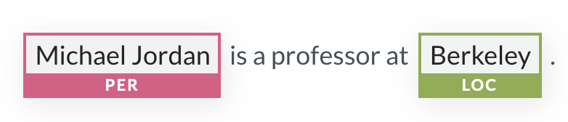
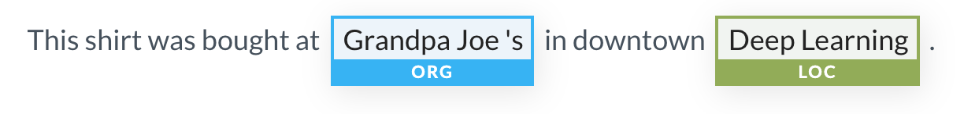
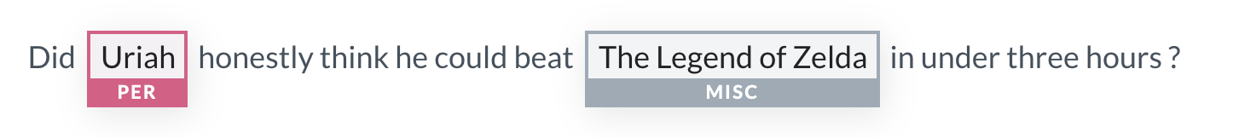
Tasks
SQuAD: question answering
SNLI: natural language inference
SRL: semantic role labeling
Coref: coreference resolution
NER: named entity recognition
SST-5: sentiment analysis
(figure credit: https://demo.allennlp.org/named-entity-recognition)
A large annotated corpus for learning natural language inference
Sang and Meudler, CoNLL Shared Task 2002

Slide 65
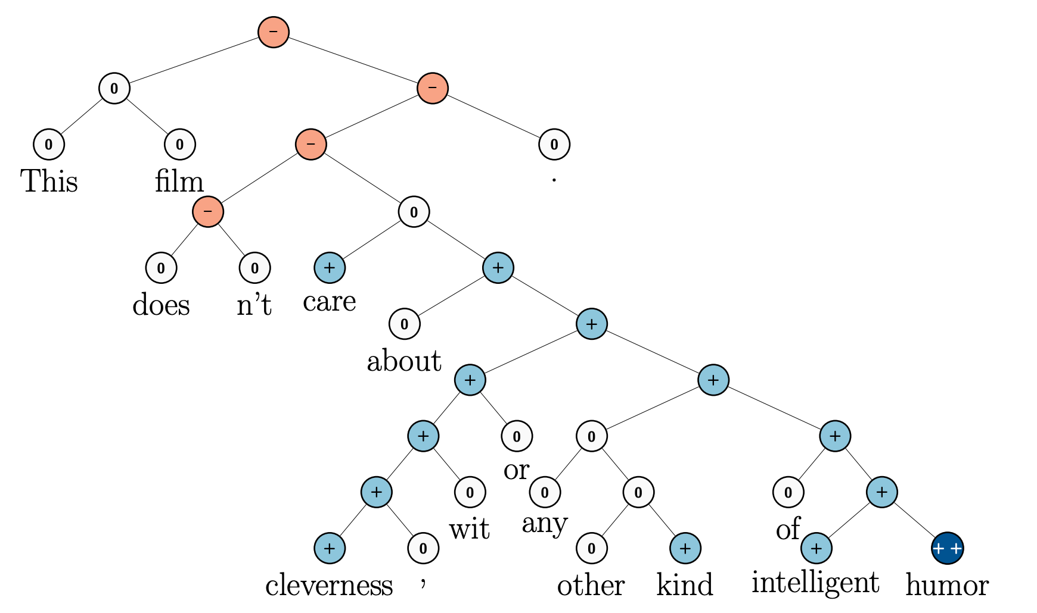
Tasks
SQuAD: question answering
Stanford Sentiment Treebank
This file doesn’t care about cleverness, wit or any other kind of intelligent humor. Negative
SNLI: natural language inference
SRL: semantic role labeling
Coref: coreference resolution
NER: named entity recognition
SST-5: sentiment analysis
5 classes
Very Positive
Positive
Neutral
Negative
Very Negative
Recursive deep models for semantic compositionality over a sentiment treebank
Socher et al, EMNLP 2013

Slide 66
Many NLP applications!
Question answering
Text generation
Information extraction
Dialogue and chatbots
…
Adapted from slides from Danqi Chen and Karthik Narasimhan
(with some content from slides from Chris Manning and Anoop Sarkar)

Slide 67
Many NLP applications!
Question answering
Text generation
Information extraction
Dialogue and chatbots
…
Adapted from slides from Danqi Chen and Karthik Narasimhan
(with some content from slides from Chris Manning and Anoop Sarkar)

Slide 68
QA Taxonomy
Context (and available information sources)
  A passage, a document, a large collection of documents, all web documents
  Knowledge base
  Semi-structured tables
  Images
Answer type
  A short span of text
  A paragraph
  Yes/No
  A database entry
  A list
Question type
  Factoid vs non-factoid
  Open-domain vs closed-domain
  Simple vs compositional

Slide 69
Textual Question Answering
Also called “Reading Comprehension”
(Rajpurkar et al, 2016): SQuAD: 100,000+ Questions for Machine Comprehension of Text

Slide 70
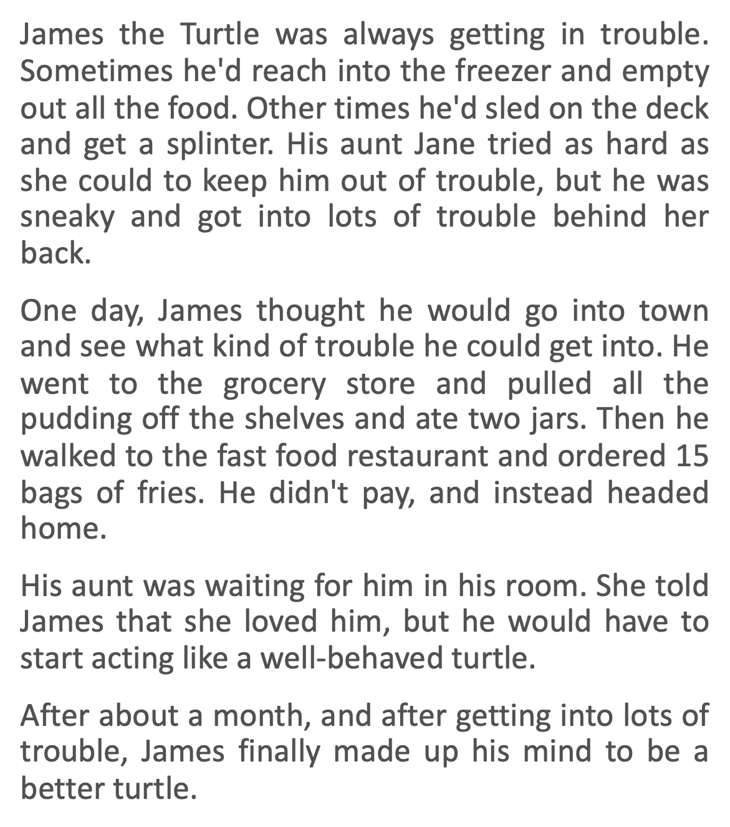
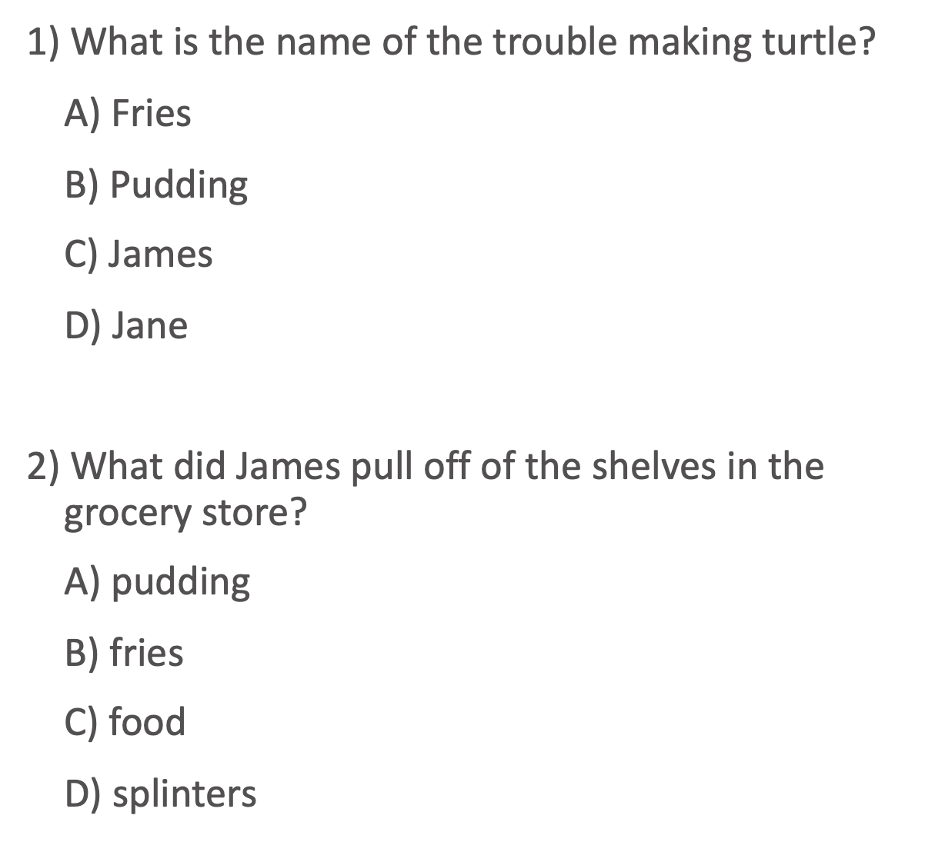
Textual Question Answering
(Richardson et al, 2013): MCTest: A Challenge Dataset for the Open-Domain Machine Comprehension of Text

Slide 71
Conversational Question Answering
The Virginia governor’s race, billed as the marquee battle of an otherwise anticlimactic 2013 election cycle, is shaping up to be a foregone conclusion. Democrat Terry McAuliffe, the longtime political fixer and moneyman, hasn’t trailed in a poll since May. Barring a political miracle, Republican Ken Cuccinelli will be delivering a concession speech on Tuesday evening in Richmond. In recent ...
Q: What are the candidates running for?
A: Governor
Q: Where?
A: Virginia
Q: Who is the democratic candidate?
A: Terry McAuliffe
Q: Who is his opponent?
A: Ken Cuccinelli
Q: What party does he belong to?
A: Republican
Q: Which of them is winning?
(Reddy & Chen et al, 2019): CoQA: A Conversational Question Answering Challenge

Slide 72
Long-form Question Answering
Abstractive:
Answer made up of novel words and sentences composed through paraphrasing
Extractive:
Select excerpts (extracts) and concatenate them to form the answer.
https://ai.facebook.com/blog/longform-qa/
(Fan et al, 2019): ELI5: Long Form Question Answering

Slide 73
Open-domain Question Answering
DrQA
Factored into two parts:
  Find documents that might contain an answer (handled with traditional information retrieval)
  Finding an answer in a paragraph or a document (reading comprehension)
(Chen et al, 2017): Reading Wikipedia to Answer Open-Domain Questions
Notes:
Document retriever and document reader

Slide 74
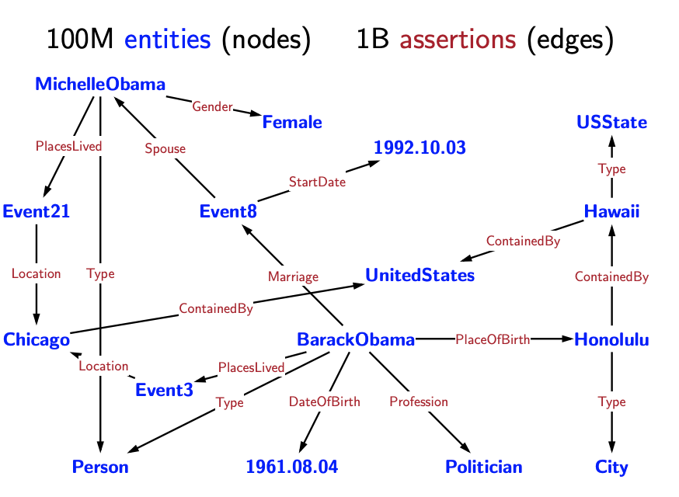
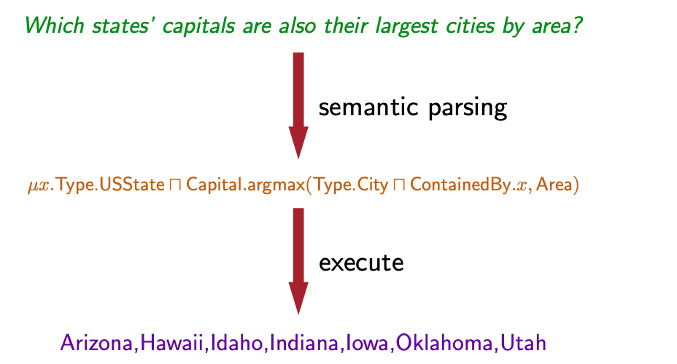
Knowledge Base Question Answering
Structured knowledge representation
QA via semantic parsing
(Berant et al, 2013): Semantic Parsing on Freebase from Question-Answer Pairs
Notes:
Structured knowledge representation.

Slide 75
Table-based Question Answering
(Pasupat and Liang, 2015): Compositional Semantic Parsing on Semi-Structured Tables.
Notes:
Figure out how to match columns with questions

Slide 76
Visual Question Answering
(Antol et al, 2015): Visual Question Answering

Slide 77
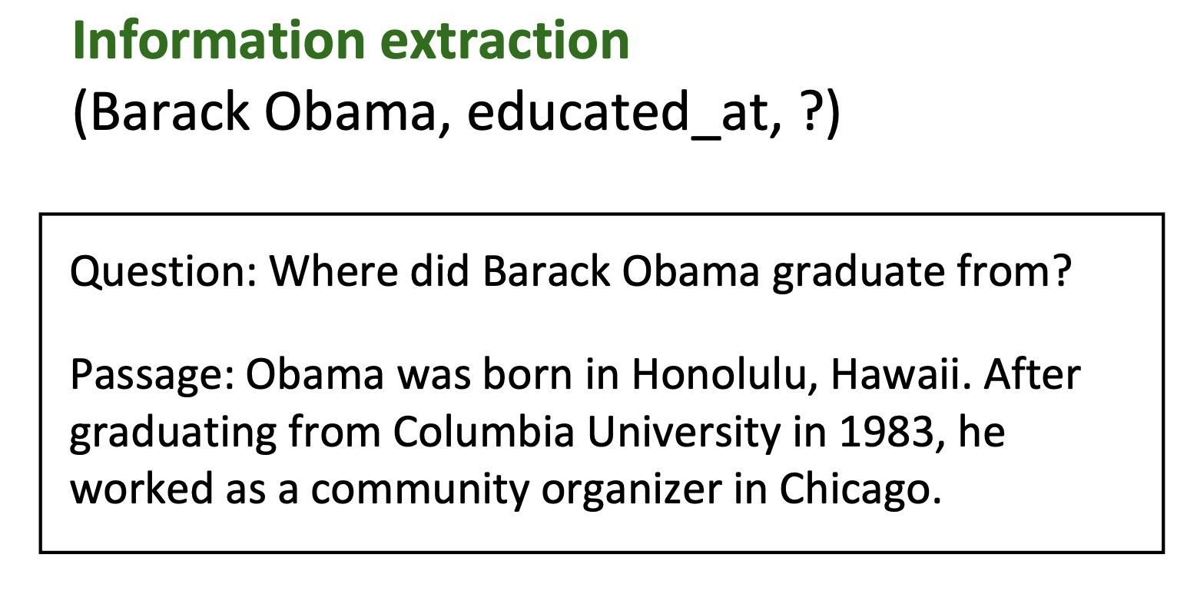
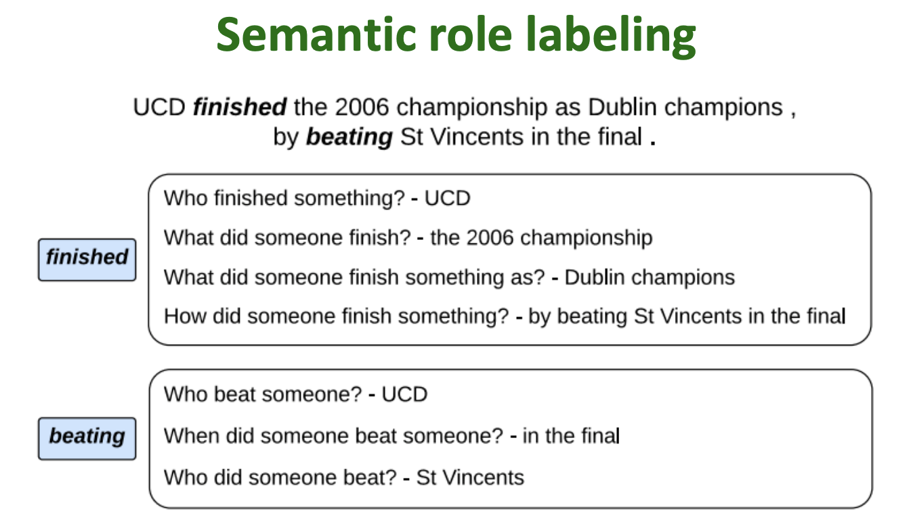
Why do we care about this problem?
Useful for many practical applications
Reading comprehension is an important testbed for evaluating how well computer systems understand human language
  Wendy Lehnert 1977: “Since questions can be devised to query any aspect of text comprehension,the ability to answer questions is the strongest possible demonstration of understanding.”
Many other NLP tasks can be reduced to a reading comprehension problem:
(Levy et al. 2017)
(He et al. 2015)
Slide credit: John Hewitt

Slide 78
Stanford Question Answering Dataset (SQuAD)
SQuAD 2.0:
Have classifier/threshold to decide whether to take the most likely prediction as answer
(passage, question, answer) triples
Passage is from Wikipedia (~100-500 words), question is crowd-sourced
Answer must be a span of text in the passage (aka. “extractive question answering”)
SQuAD 1.1: 100k answerable questions, SQuAD 2.0: another 50k unanswerable questions
https://stanford-qa.com
(Rajpurkar et al, 2016): SQuAD: 100,000+ Questions for Machine Comprehension of Text
Notes:
Large-scale supervised datasets are also a key ingredient for
training effective neural models for reading comprehension!
SQuAD was for years the most popular reading comprehension
dataset; it is “almost solved” today (though the underlying task is
not,) and the state-of-the-art exceeds the estimated human
performance

Slide 79
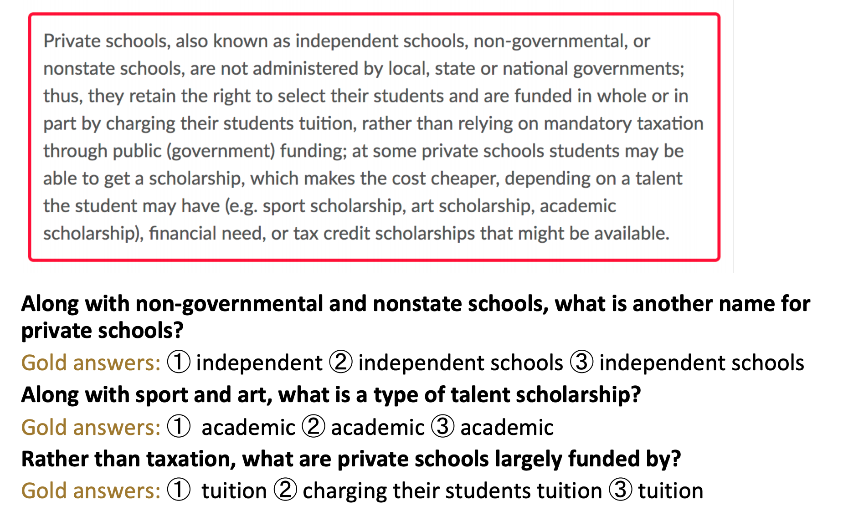
Stanford Question Answering Dataset (SQuAD)
3 gold answers are collected for each question
Slide credit: Chris Manning
Notes:
3 gold answers are collected for each question

Slide 80
Stanford Question Answering Dataset (SQuAD)
SQuAD 1.1 evaluation:
  Two metrics: exact match (EM) and F1
    Exact match: 1/0 accuracy on whether you match one of the three answers
    F1: take each gold answer and system output as bag of words, compute precision, recall and harmonic mean. Take the max of the three scores.
  Final exact match and F1 are average of instance exact and F1 scores
  Estimated human performance: EM = 82.3, F1 = 91.2
Example
Q: What did Tesla do in December 1878?
A: {left Graz, left Graz, left Graz and severed all relations with his family}
Prediction: {left Graz and served}
Exact match: max{0, 0, 0} = 0
F1: max{0.67, 0.67, 0.61} = 0.67
(Rajpurkar et al, 2016): SQuAD: 100,000+ Questions for Machine Comprehension of Text
Notes:
F1 measure is seen as more reliable and taken as primary
• It’s less based on choosing exactly the same span that humans chose,
which is susceptible to various effects, including line breaks
• Both metrics ignore punctuation and articles (a, an, the)

Slide 81
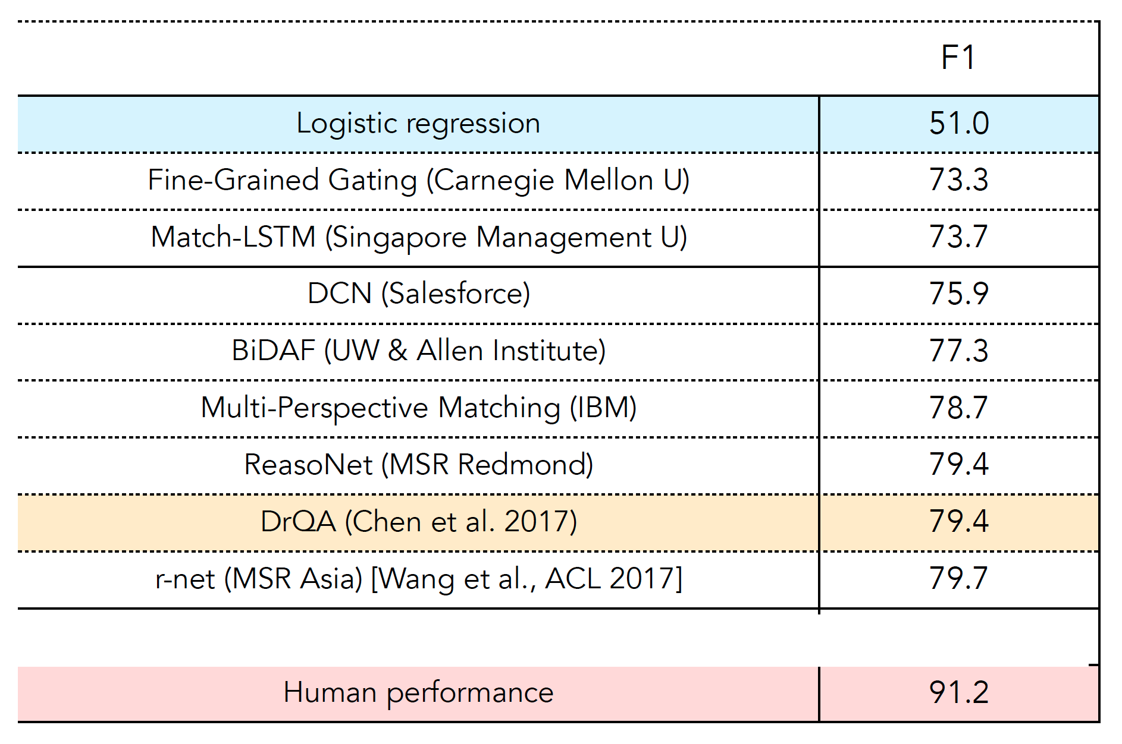
SQuAD v1.1 performance (2017)
Slide credit: Chris Manning

Slide 82
Experiments on SQuAD v1.1
F1
Logistic
Regression
BiDAF++
+
Human
Performance
state-of-the-art
XLNet
(as of Nov 2019)
*: single model only
Notes:
Human performance: human judged against two other humans (vs computers judged against 3 humans)
BiDAF++ (https://arxiv.org/pdf/1710.10723.pdf) Simple and Effective Multi-Paragraph Reading Comprehension

Slide 83
Many NLP applications!
Question answering
Text generation
Information extraction
Dialogue and chatbots
…
Adapted from slides from Danqi Chen and Karthik Narasimhan
(with some content from slides from Chris Manning and Anoop Sarkar)

Slide 84
Many tasks and applications for
natural language generation (NLG)
Task/Application | Input | Output
Machine Translation | French | English
Summarization | Document | Short Summary
Dialogue | Utterance Dialog history | Response
Image Captioning | Image | Caption
Story Generation | Prompt | Story
Notes:
Machine Translation:
- input: utterances in source languages
- output: translated text in target languages.
Digital assistant (dialogue) systems use NLG
input: dialog history
output: text that respond / continue the conversation
Summarization systems (for research articles, email, meetings, documents) use NLG
- input: long documents
- output: summarization of the long documents

Slide 85
Many tasks and applications for
natural language generation (NLG)
Task/Application | Input | Output
Free form question answering | Question + context | Answer
Lyric generation | Music + topic | Lyrics
Table summarization | Table | Description
Code summarization | Code | Description
Code generation | Prompt | Code
Notes:
Machine Translation:
- input: utterances in source languages
- output: translated text in target languages.
Digital assistant (dialogue) systems use NLG
input: dialog history
output: text that respond / continue the conversation
Summarization systems (for research articles, email, meetings, documents) use NLG
- input: long documents
- output: summarization of the long documents

Slide 86
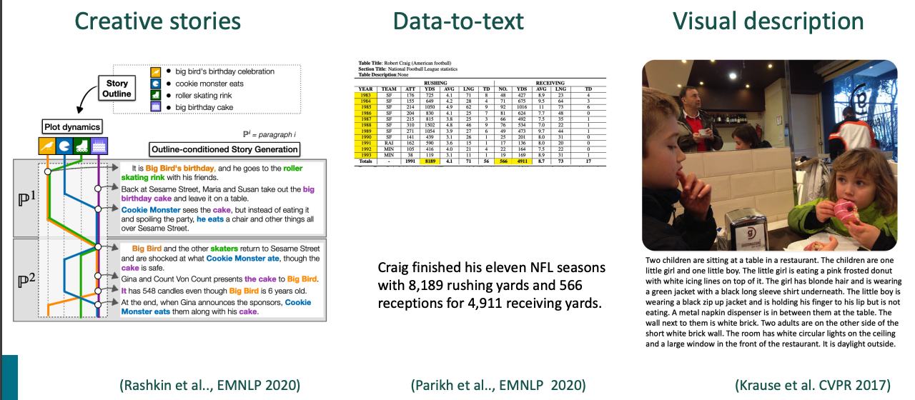
Examples of NLG
Slide adapted from Stanford CS224N (Xiang Lisa Li, Antoine Bosselut, Chris Manning)

Slide 87
Spectrum of NLG tasks
Machine
Translation
Summarization
Machine Translation
Source Sentence: 当局已经宣布今天是节假日。
Reference Translations:
Authorities have announced a national holiday today.
Authorities have announced that today is a national holiday.
Today is a national holiday, announced by the authorities.
Output space not very diverse
Slide adapted from Stanford CS224N (Xiang Lisa Li, Antoine Bosselut, Chris Manning)

Slide 88
Spectrum of NLG tasks
Machine
Translation
Summarization
Task-driven
Dialog
ChitChat
Dialog
ChitChat Dialog
Input: Hey, how are you?
Outputs:
Good! You?
I just heard an exciting news, do you want to hear it?
Thx for asking! Barely surviving my hws.
More possible “correct” generations
Slide adapted from Stanford CS224N (Xiang Lisa Li, Antoine Bosselut, Chris Manning)

Slide 89
Spectrum of NLG tasks
Machine
Translation
Summarization
Task-driven
Dialog
ChitChat
Dialog
Story
Generation
Story Generation
Input: Write a story about three little pigs?
Outputs:
… (lots of different options!)…
Very open-ended!
Slide adapted from Stanford CS224N (Xiang Lisa Li, Antoine Bosselut, Chris Manning)

Slide 90
Spectrum of NLG tasks
Less open-ended
More open-ended
Machine
Translation
Summarization
Task-driven
Dialog
ChitChat
Dialog
Story
Generation
Less diverse
More diverse
Lots of freedom in the output, output distribution should be varied and diverse
Output is mostly determined by the input
Can characterize the spectrum of tasks using entropy.
Can use different decoding and training strategies for each.
Slide adapted from Stanford CS224N (Xiang Lisa Li, Antoine Bosselut, Chris Manning)

Slide 91
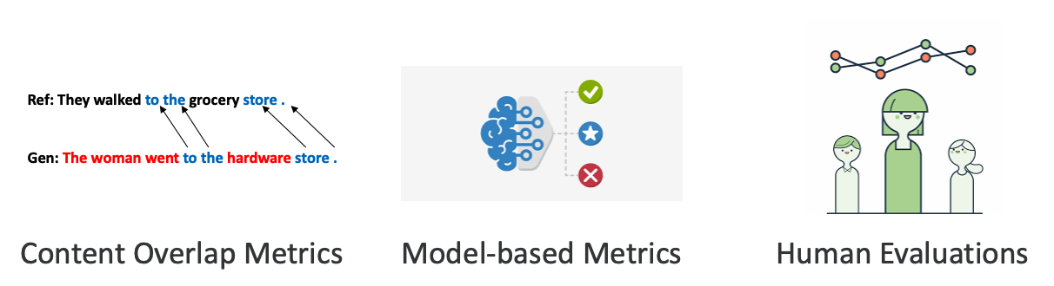
Evaluation
Slide adapted from Stanford CS224N (Xiang Lisa Li, Antoine Bosselut, Chris Manning)

Slide 92
Automatic evaluation metrics
Content overlap metrics:
  Word (n-gram) overlap: BLEU, ROUGE, METEOR, CIDEr
  Structured overlap: PYRAMID, SPICE, SPIDER
Model based metrics:
  Embedding similarity: Embedding average, Word Mover Distance, BERTSCORE, etc.
  Metric predictor: BLEURT
LLM as judge:
Notes:
Evaluation is crucial in dialogue system design. How can we tell if a dialogue system is fulfilling its goal?
Task-based dialogue is evaluated mainly by measuring whether they succeed at their task, like booking the right flight.
For chatbots, often the goal is to be enjoyable to humans. So chatbots are evaluated by humans.
Let's begin with chatbots. We evaluate these by asking humans to assign a score. This can be the human who talked to the chatbot (which we call participant evaluation) or a third party who reads a transcript of a human/chatbot conversation (which we call observer evaluation).

Slide 93
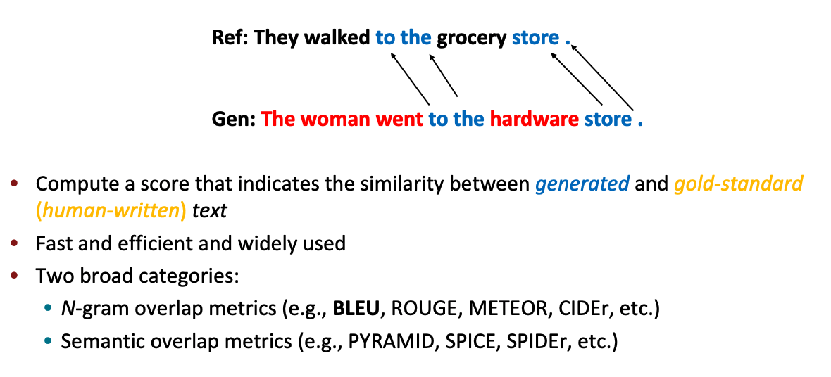
Content overlap metrics
Slide credit Stanford CS224N (Xiang Lisa Li, Antoine Bosselut, Chris Manning)

Slide 94
N-gram overlaps are not good metrics
Word overlap-based metrics: BLEU, ROUGE, METEOR, CIDEr, etc
Not ideal for machine translation
But they get even progressively worse for tasks that are more open-ended than machine translation
  Worse for summarization, as longer output texts are harder to measure
  Much worse for dialogue, which is more open-ended that summarization
  Much, much worse story generation, which is also open-ended, but whose sequence length can make it seem you’re getting decent scores!
Slide adapted from Stanford CS224N (Xiang Lisa Li, Antoine Bosselut, Chris Manning)

Slide 95
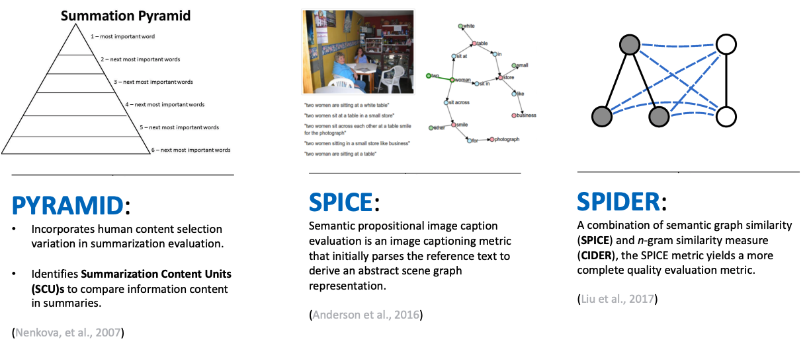
Semantic overlap metrics
Slide adapted from Stanford CS224N (Xiang Lisa Li, Antoine Bosselut, Chris Manning)

Slide 96
Model-based metrics
Use learned representations of words and sentences to compute semantic similarity between generated and reference texts
No more n-gram bottleneck because text units are represented as embeddings!
Even though embeddings are pretrained, distance metrics used to measure the similarity can be fixed
Slide adapted from Stanford CS224N (Xiang Lisa Li, Antoine Bosselut, Chris Manning)

Slide 97
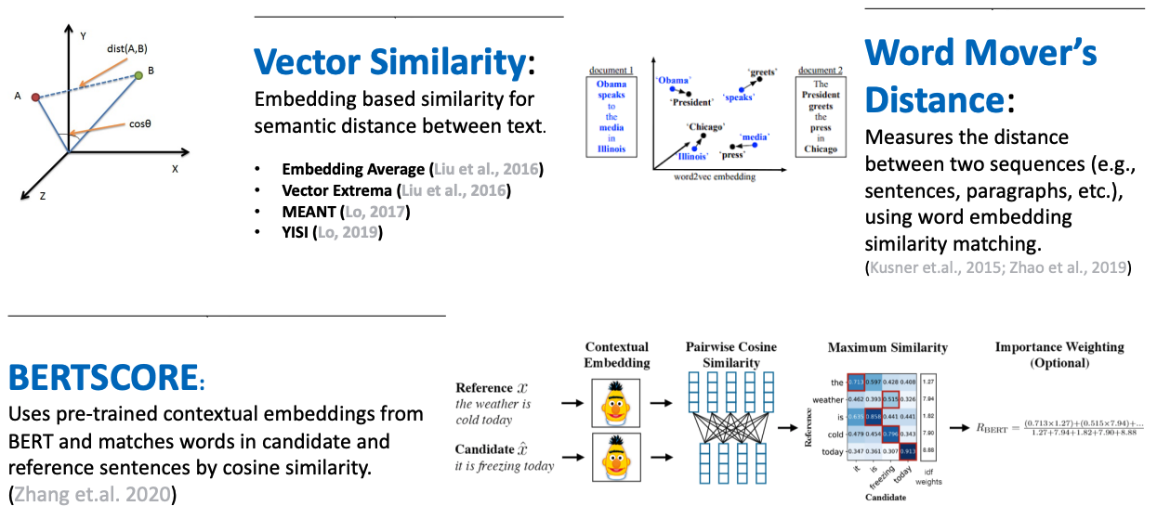
Model-based metrics: Word distance functions
Slide adapted from Stanford CS224N (Xiang Lisa Li, Antoine Bosselut, Chris Manning)

Slide 98
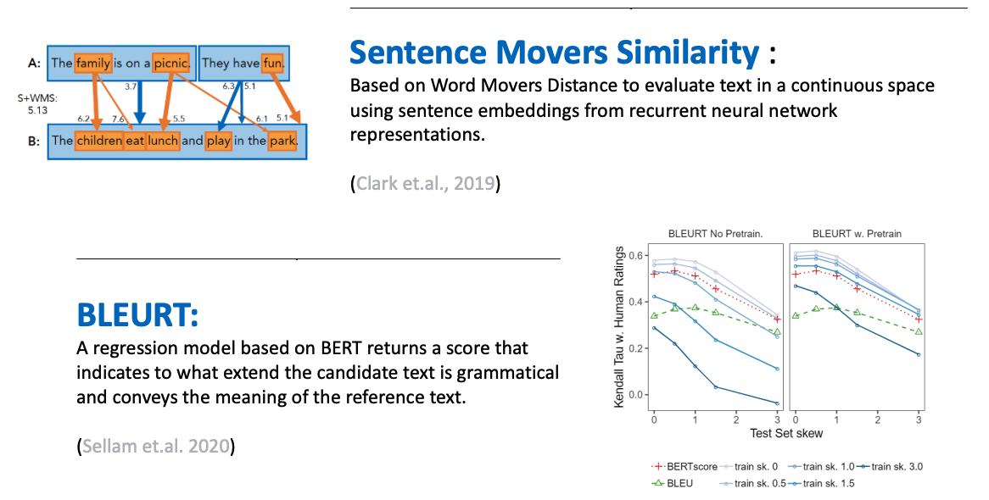
Model-based metrics: Beyond word matching
Slide adapted from Stanford CS224N (Xiang Lisa Li, Antoine Bosselut, Chris Manning)

Slide 99
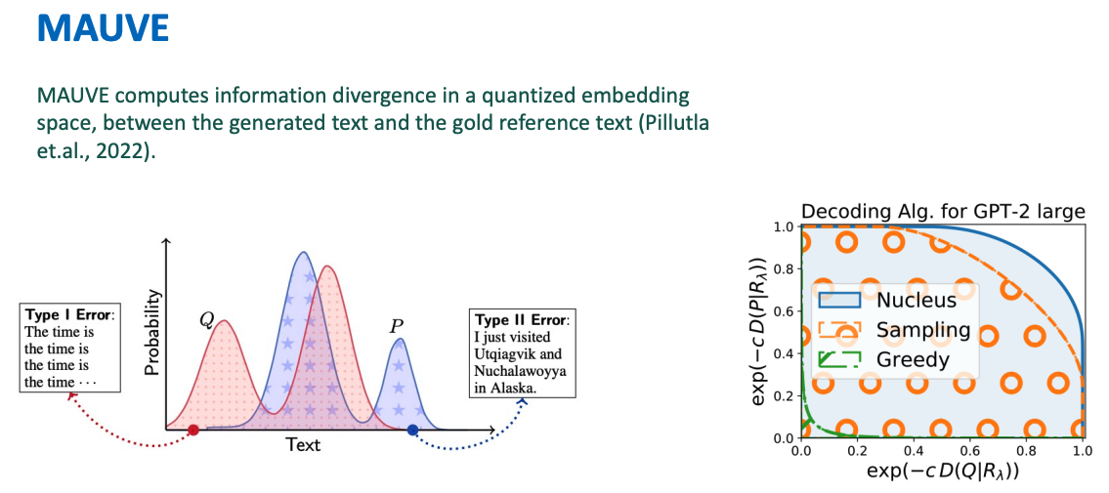
Evaluating open-ended text generation
Slide adapted from Stanford CS224N (Xiang Lisa Li, Antoine Bosselut, Chris Manning)

Slide 100
MAUVE
https://openreview.net/pdf?id=Tqx7nJp7PR

Slide 101
Human evaluation
What kind of human evaluation can be done?
Can get ratings from chat participants or external observers.
Can ask humans to rate various aspects of the chat (likert scale) or to compare two chats / responses (AB testing)
Dimensions: fluency, coherence / consistency, factuality and correctness, commonsense, style / formality, grammaticality, typicality, redundancy
Issues with human evaluation
slow, expensive
not repeatable (subjective/inconsistent)
difficult to form well-targeted questions that are not open to misinterpretation
When developing new automatic metrics, human evaluation is used as gold
New automated metrics must correlate well with human evaluation.
Notes:
Evaluation is crucial in dialogue system design. How can we tell if a dialogue system is fulfilling its goal?
Task-based dialogue is evaluated mainly by measuring whether they succeed at their task, like booking the right flight.
For chatbots, often the goal is to be enjoyable to humans. So chatbots are evaluated by humans.
Let's begin with chatbots. We evaluate these by asking humans to assign a score. This can be the human who talked to the chatbot (which we call participant evaluation) or a third party who reads a transcript of a human/chatbot conversation (which we call observer evaluation).

Slide 102
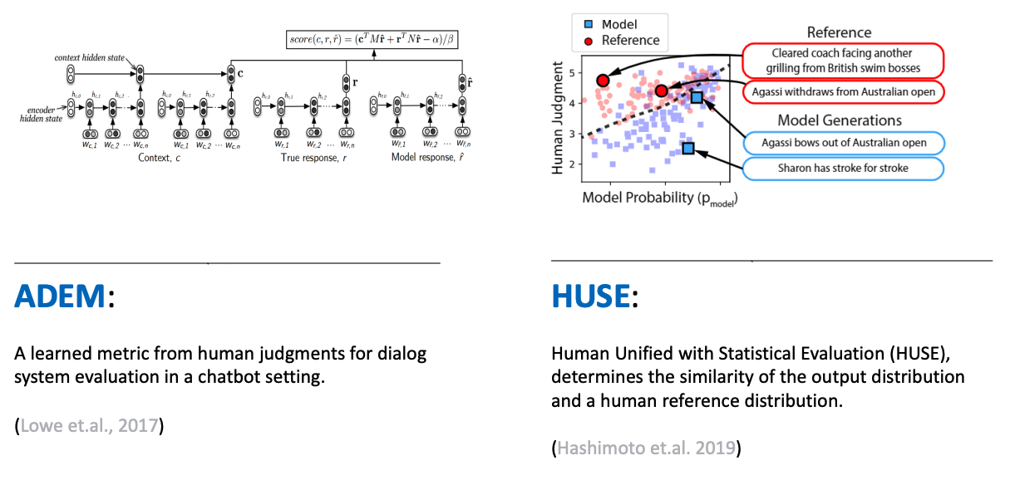
Learning from human feedback
Slide credit Stanford CS224N (Xiang Lisa Li, Antoine Bosselut, Chris Manning)

Slide 103
Evaluation takeaways
Content overlap metrics provide a good starting point for evaluating the quality of generated text, but they’re not good enough on their own.
Model-based metrics can be more correlated with human judgment, but metric may not be not interpretable
Human judgments are critical
  But humans are inconsistent and judgments are expensive
If you are developing a NLG system, you should
  Look at your model generations. Don’t just rely on numbers!
  Publicly release large samples of the output of systems that you create!
Slide adapted from Stanford CS224N (Xiang Lisa Li, Antoine Bosselut, Chris Manning)
Notes:
People can misinterpret question

Slide 105
Announcements
Project abstract is due Wednesday 10/26, by 11:59pm
  Not graded
  Full project proposal is due on 11/1
HW3 out this week
HW1 grades will be out later this week
Academic honesty

Slide 106
Today
Sequence modeling
  HMMs (Hidden Markov Models)
  Recurrent Neural Networks (RNNs)

Slide 107
Announcements
Project proposal is due Tuesday 11/1, by 11:59pm
  Please submit on Gradescope
  Please indicate all members of group
Project milestone due Friday 11/18, by 11:59pm
HW1 grades released, HW2 grades will be out later this week
HW3 due next Wednesday 11/9, by 11:59pm

Slide 108
Announcements
Interactive Tutorial Session
  Wednesday 1:00pm to 1:30pm - Training and debugging tips for neural networks
  Video will be out tonight

Slide 109
Today
Sequence modeling and decoding
  LSTMs / GRUs
  Sequence generation
Recorded lecture will be put up later in the week
Video lectures (optional) on Statistical Machine Translation

Slide 110
Announcements
HW3 due Wednesday 11/9, by 11:59pm
Project milestone due next Friday 11/18, by 11:59pm
HW2 grades will be out tonight, project proposal grades later this week

Slide 111
Announcements
Interactive Tutorial Session
  Wednesday 1:00pm to 1:30pm - Using transformers and pretrained contextual embeddings with huggingface
  Video will be out tonight

Slide 112
Today
Transformers
Project milestone
Contextual word embeddings
Recorded lecture will be put up later in the week

Slide 113
What is your project about?
Lecture
  Teach you about specific models (FFN,RNN/Transformers)
  Focus is on the inner workings of the model and how it is hooked up
Papers
  Invent a new model / loss / training
  Will describe whatever is new in detail
What should you focus on describing?
  What is your project about?
  Think about what do you need to explain

Slide 114
What is your project about?
What is your project about?
  Applying FFN, RNN, BERT to text-classification
    Explain your input/output
    Explain how FFN, RNN, BERT is hooked up with input, output
      Draw a diagram
    Explain how you will train the model (what loss function?, what optimizer?)
    Explain

Slide 115
Announcements
HW2 due today 10/12
Project abstract / title due Thursday 10/21
  Not graded
Project Proposal due Thursday 10/28 (5%)

Slide 116
Project Proposal
(due 3/4 - 5%)
What problem are you addressing? Why is it interesting?
  Provide specifics of your tasks (e.g. input/output concrete examples)
What specific aspects will your project be on?
  Re-implement paper? Compare different methods?
What data do you plan to use?
What is your method?
  What do you plan to implement? Are there existing codebases you will use?
How do you plan to evaluate? What metrics?
What computational resources will you need?

Slide 117
Announcements
HW2
  HW2-q due yesterday (10/15 11:59pm)
    Gradescope: https://www.gradescope.ca/
  HW2-p grace period until tonight (10/16 11:59pm)
Project
  Initial abstract/title due today (not graded) for initial feedback
    If in by Sunday, we will try to give feedback
  Proposal due in a week (10/23, 11:59pm)
Tutorial on neural network training tips and running experiments

Slide 118
  Announcements
HW3-P (programming component) due Wednesday Oct 28th
HW3-Q (question-answering) due Thursday Oct 29th
    Gradescope: https://www.gradescope.ca/
Grade for HW2 out later today
Project proposal due today (by 11:59pm)
  What problem are you addressing? Why is it interesting?
  What specific aspects will your project be on?
    Re-implement paper? Compare different methods?
  What data do you plan to use?
  What is your method?
  How do you plan to evaluate? What metrics?

Slide 119
  Announcements
No class next Wednesday, Nov 11th (holiday!)
HW4-P (programming component) due Wednesday Nov 11th (make sure to submit something by then)
HW4-Q (question-answering) due Thursday Nov 12th
    Gradescope: https://www.gradescope.ca/
    If hand writing answers, please write clearly
Grade for HW3-P and HW3-C out this evening

Slide 121
Project Details
Project proposal feedback out this evening
Project milestone due Friday 11/20 (more details next week)
  Build on what you have done for the proposal
  Include progress and initial results
  Include dataset examples and statistics
  Include figures for your model
  Include references
  Make it clear what you are implementing vs what part you are building on top of existing libraries / codebases / homework
Project “Poster” presentation on last day of this class (Tuesday 12/7) - tentative plan
  Before 12/4: Short video (3 min) summarizing your project
  Per group zoom link that others can use to visit your presentations
    Use slides/material prepared for video
  Split into session A/B (each 1hr)
Project final report due last day of all classes (Tuesday 12/8)
Notes:
a paper written in the style of a conference (e.g., ACL) submission

Slide 122
Project Details
Project proposal feedback out this evening
Project milestone due Thursday 11/18
Project “Poster” presentation on last day of this class (Tuesday 12/7) - tentative plan
  By 12/5: Short video (3 min) summarizing your project
  Per group zoom link that others can use to visit your presentations
    Use slides/material prepared for video
Project final report due last day of all classes (Wednesday 12/8)
Notes:
a paper written in the style of a conference (e.g., ACL) submission

Slide 123
  Announcements
No class next Wednesday, Nov 25th
  Angel at Emerging Technologies: BC's AI Showcase
  Will post link to some interesting NLP stuff to watch
Project milestone due today by 11:59pm
Grade for HW4-P and HW4-C out by early next week

Slide 124
  Announcements
Wednesday, April 8th - Project presentations
  Project video due April 6th
Thursday, April 9th - Everything due
  Final project report, code, output
    Include breakdown of member contributions!
  Participation: Short video report + survey
    Google form survey
    Official CES survey

Slide 125
Participation reminder
3% of grade
Final Project
No grace days
Video - Upload by Monday 4/6
  3 minutes, upload to either SFU vault or YouTube (unlisted)
Presentation
  Wednesday 4/8 will be project presentations + conclusion
  We will have 6 streams (online) with TAs / evaluators
  You will get a time slot for a live presentation + Q&A
Add video link to shared spreadsheet
Report - Due Thursday 4/9 11:59pm

Slide 126
Project “Poster”
Project “Poster” presentation on last day of this class (Wednesday 4/8)
By Monday 4/6
  Short video (3 min) summarizing your project
  What problem are you addressing? Why is it interesting?
  What approach did you take? What model did you use?
  What did you do for your experiments? What interesting findings did you observe?
  Use visuals!
Notes:
a paper written in the style of a conference (e.g., ACL) submission

Slide 127
Participation
3% of grade
Based on helpful questions and comments on discussion forum
We will also consider class attendance
What if you haven’t participated?
Up to 0.5% bonus (on top of the normal 3%)
Watch other group’s project videos
  To show that you watched the video, you will need to prepare a short report
  Each student must do one video report (watch one video)
  We will take up to 3 video reports per student (0.25% each)
Complete Google survey about class (0.25%)
  You have to provide your name and answer most of the question to get credit

Slide 128
Participation: Short report on other group’s video
For the short video report (0.5 page), you should include
Other group’s project name, and title
Summary of what the other group’s project about
Summary of what their key findings are
2-3 things that you thought the other group did well
  Examples: they had very careful experiments, they worked on a really interesting task
2-3 things that you thought the other group could do better:
  Examples: They didn’t explain why model 1 performed poorly. Their video was difficult to understand.
Short report will be graded as 0, 0.5 (half-baked), or 1 (good job)

Slide 129
Final project report
8 pages not including references
Model or what approach you are taking
Title
Rough page layout: your report can have different number of pages for each section
Conventions for communicating the work you have done.
More importantly, what insights have you gained and what can others take away from your work?

Slide 130
Details of what goes into a paper
1. Intro: Tell the full story of your paper at a high-level.
2. Related Work: Contextualize your work and provide insights into major relevant themes of the literature as a whole. Use each paper (or theme) as a chance to articulate what is special about your paper.
3. Data: Likely to be very detailed if the datasets are new or unfamiliar to the community, or if familiar datasets are being used in new ways.
4. Model: Flesh out your own approach, perhaps amplifying themes from the ‘Related work’ section.
5. Experiments: The experimental approach, including descriptions of metrics, baseline models, etc. Details about hyperparameters, optimization choices, etc., are probably best given in appendices, unless they are central to the arguments.
6. Results: A no-nonsense report of what happened.
7. Analysis: Discussion of what the results mean, what they don’t mean, where they can be improved, etc. These sections vary a lot depending on the nature of the paper.
8. (For papers reporting on experiments with multiple datasets, it can be good to repeats Methods/Results/Analysis in separate (sub)sections for each dataset.)
9. Conclusion: Quickly summarize what the paper did, and then chart out possible future directions that anyone might pursue.
Slide credit: Chris Potts
Notes:
https://web.stanford.edu/class/cs224u/slides/cs224u-2021-presenting-part2-handout.pdf
https://web.stanford.edu/class/cs224u/slides/cs224u-2021-presenting-part1-handout.pdf

Slide 131
Project video
~3 minutes. Upload to SFU vault or Youtube (unlisted) by 4/6
Add link to shared Google spreadsheet
How to prepare your video
  Prepare a slide deck using powerpoint/keynote/google slides
  Many different ways to record video depending on platform/application.
    Using zoom: https://www.howtogeek.com/662780/how-to-record-a-zoom-meeting/
    If you have trouble, post on Coursys Discussion Forum and ask for help, hopefully you can get advice from experienced classmates and TAs.

Slide 132
What goes into your video
What goes into your video:
  Same things that goes into your final report! But more visual, with less details.
  You should prepare diagrams, figures and visualizations for your video and presentation.
  You should reuse some of these content for your final report.

Slide 133
What goes in your video
Problem: what problem you are tackling and why it’s important
  If you are doing something new, what are current approaches are and their limitations, and what is the insight of your approach that allows you to solve the problem better.
Data/Task: Briefly explain (or better, give examples of) the data and/or task.
  Clearly specify your input and output, give examples.
  Provide statistics (tables or charts) for your data.
Approach: Describe your main methods/techniques/models. Diagrams are generally better than text, and equations should be used sparingly (if at all). Highlight the core idea of your techniques.
Results: Present your most important results. Tables containing many numbers are overwhelming. Be selective and choose just the results that convey the story you’re telling. Make it clear what the evaluation metrics are, and what’s being compared.
Analysis: Show any plots, diagrams, examples and visualizations to provide interesting analysis. Make it clear what the reader should conclude from each figure.
Conclusions: Briefly draw some main conclusions from your work. If you wish, you can outline future work.
References: Make sure to include proper citations for prior work mentioned in slides.
For your report, you should also indicate what you have implemented and what other code you have used.
For your report, you can/should have more formal mathematical notations
For your report, you will have more detailed tables
For your report, you will have more complete references

Slide 134
Tips for final report
Proof-read your paper and fix grammar/wording issues
Include diagrams to explain your problem statement (input/output), network architecture
Include tables/graphs for data statistics and experiment results
Provide clear examples
Provide comparisons and analysis of results

Slide 135
Tips for good final projects
Have a clear, well-defined hypothesis to be tested
(++ novel/creative hypothesis)
Conclusions and results should teach the reader something
Meaningful tables, plots to display the key results
++ nice visualizations or interactive demos
++ novel/impressive engineering feat
++ good results

Slide 136
What to avoid
All experiments run with prepackaged source - no extra code written for model/data processing
Just ran model once or twice on the data and reported results (not much hyperparameter search done)
A few standard graphs: loss curves, accuracy, without any analysis
Results/Conclusion don’t say much besides that it didn’t work
  Even if results are negative, analyze them

Slide 137
What to avoid
Taking screenshots of your data or your evaluation
  Try to type it up and organize it properly in your report
  Your report should NOT be a dump of your screenshots/code
Taking images from other source and not citing them!

Slide 138
Tips for the final report

Slide 139
What makes for a good paper?(example paper)
A Thorough Examination of the CNN/Daily Mail Reading Comprehension Task
https://aclanthology.org/P16-1223.pdf (Chen et al, ACL 2016, Outstanding Paper)

Slide 140
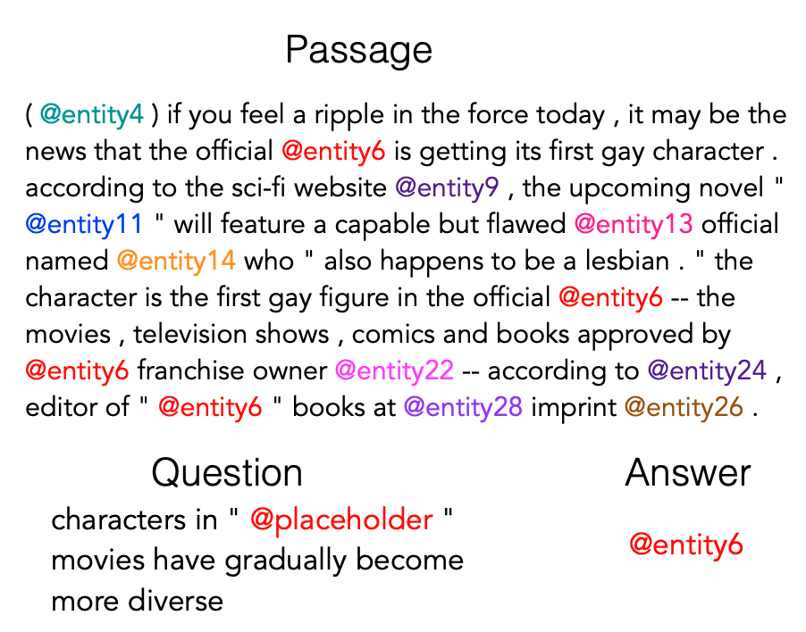
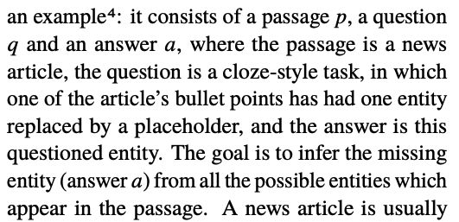
Task definition
Example with input and output
Taken from the Reading Comprehension dataset introduced by Herman et al, 2015
Text describing the problem
Goal: identify entity that is goes where @placeholder goes
A Thorough Examination of the CNN/Daily Mail Reading Comprehension Task
https://aclanthology.org/P16-1223.pdf (Chen et al, ACL 2016, Outstanding Paper)

Slide 141
Task definition
Dataset is automatically generated
  Use Google NLP pipeline and get entities and coreference chains
  Cloze-style (fill in the blank) questions generated by taking sentence from passage and replacing entity reference with @placeholder
  Data is anonymized (entities are just @entity#)
Example with input and output
Taken from the Reading Comprehension dataset introduced by Herman et al, 2015
Goal: identify entity that is goes where @placeholder goes
A Thorough Examination of the CNN/Daily Mail Reading Comprehension Task
https://aclanthology.org/P16-1223.pdf (Chen et al, ACL 2016, Outstanding Paper)

Slide 142
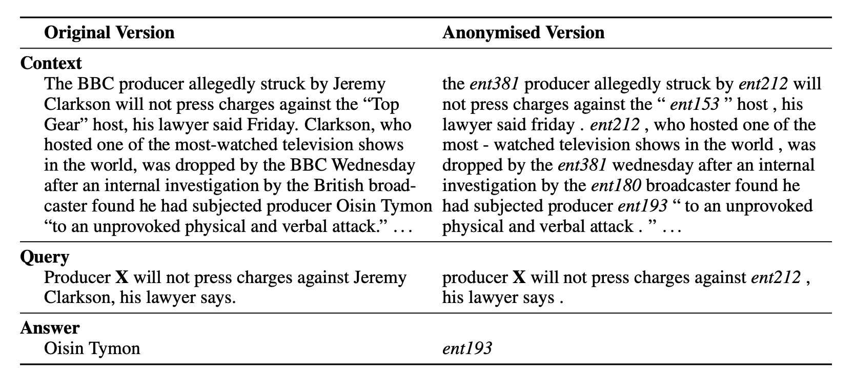
Anonymization
Teaching machines to read and comprehend
https://arxiv.org/pdf/1506.03340.pdf (Hermann et al, NIPS 2015)

Slide 143
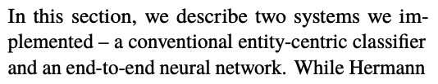
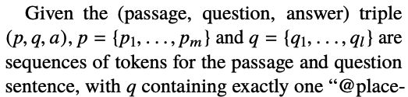
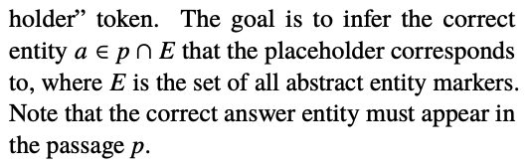
Approach
Two approaches presented
Describe problem again (with math symbols)
Features are described for entity-centric classifier
A Thorough Examination of the CNN/Daily Mail Reading Comprehension Task
https://aclanthology.org/P16-1223.pdf (Chen et al, ACL 2016, Outstanding Paper)

Slide 144
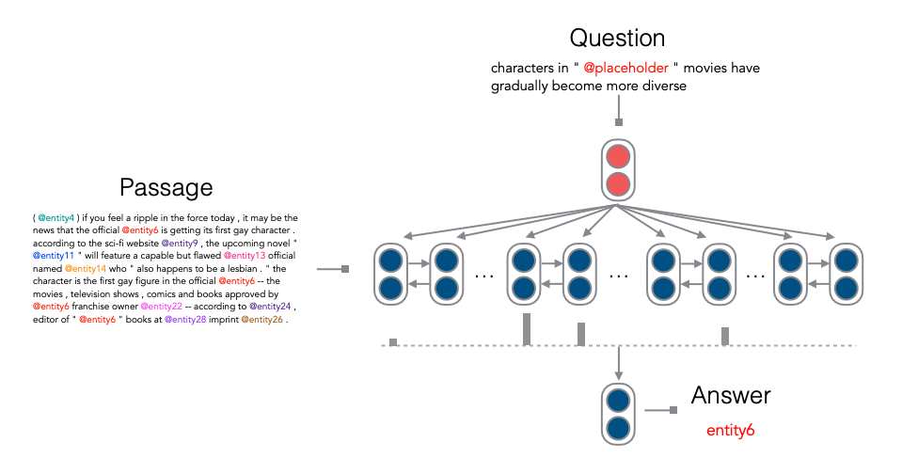
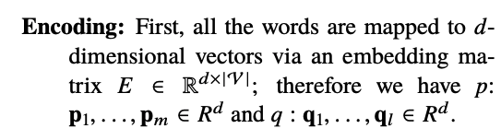
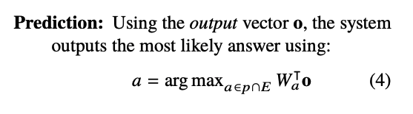
Model description
Describe key parts including how it is hooked out to input and how prediction is made
Model architecture with input and output
Symbols are connected
A Thorough Examination of the CNN/Daily Mail Reading Comprehension Task
https://aclanthology.org/P16-1223.pdf (Chen et al, ACL 2016, Outstanding Paper)

Slide 145
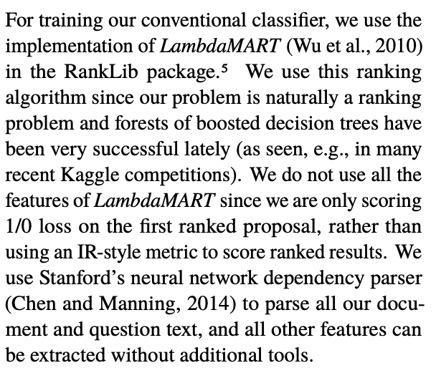
Provide implementation and training details
Training Details (for entity-centric model)
What external software / code was used
Why was it used?

Slide 146
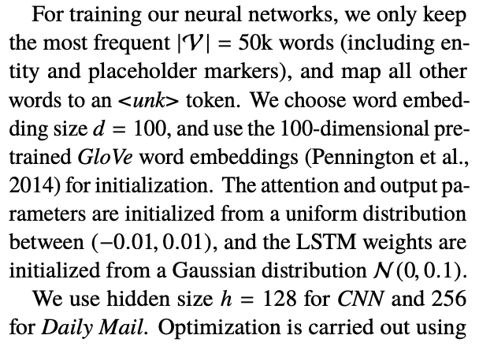
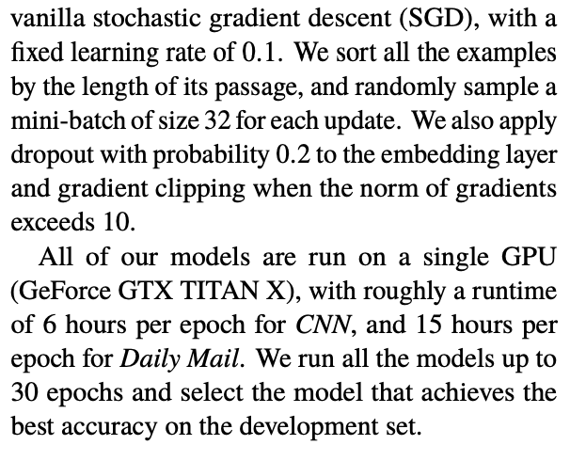
Provide implementation and training details
Training Details (for NN model)
Vocabulary size, UNK handling
Word embeddings
Parameter initialization
Dimensions (LSTM hidden state, word embeddings)
Optimizer: type, learning rate, mini-batch size, dropout
Number of epochs trained, how the “best” model was selected
Compute resource uses (GPU type, runtime)

Slide 147
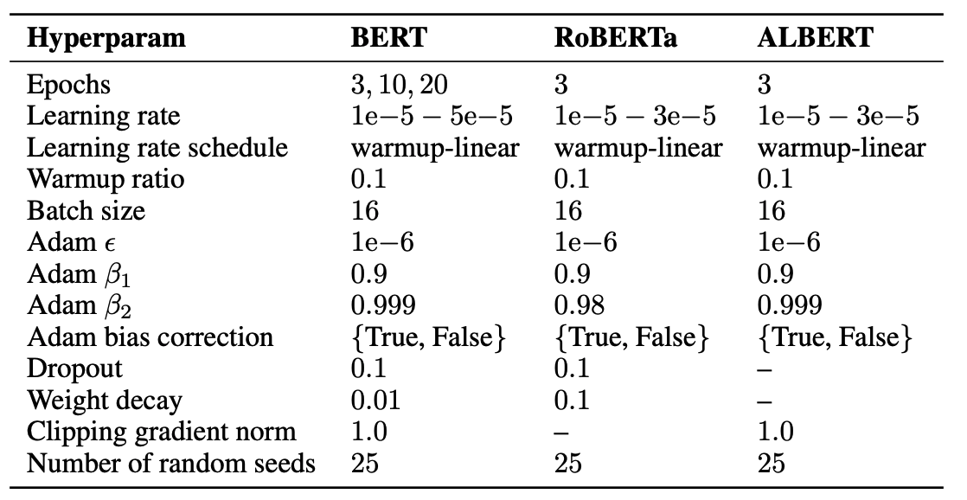
Provide implementation and training details
Organize hyper parameters in a table if appropriate
On the stability of fine-tuning BERT: Misconceptions, explanations, and strong baselines
https://arxiv.org/pdf/2006.04884v3.pdf (Mosbach et al, ICLR 2021)

Slide 148
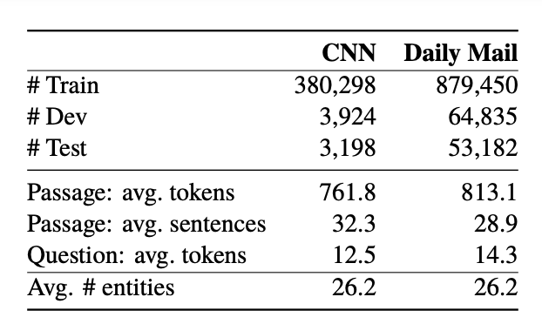
Provide data statistics
Statistics about what goes into train/val/test
NLP specific statistics (number of tokens, sentences, unique words, etc)
A Thorough Examination of the CNN/Daily Mail Reading Comprehension Task
https://aclanthology.org/P16-1223.pdf (Chen et al, ACL 2016, Outstanding Paper)

Slide 149
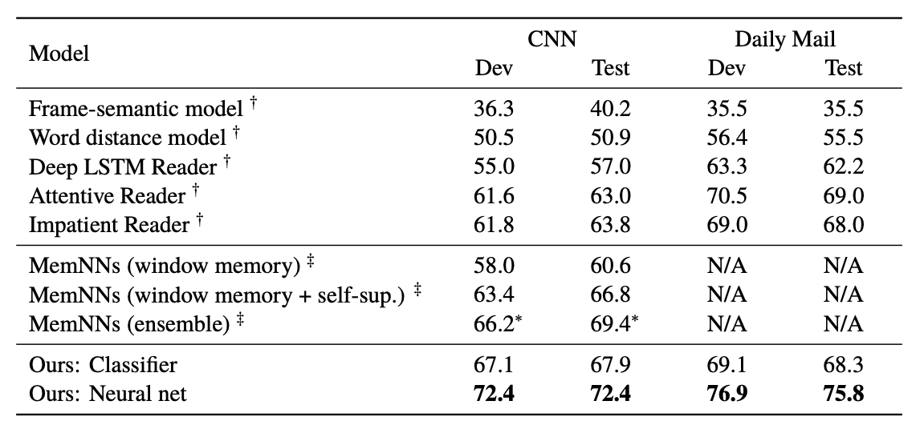
Summarize your results in tables
Describe key findings in the text
(Hermann
et al., 2015)
(Hill et al., 2016)
Ranking classifier with decision forests
Careful feature selection
NN Model is similar to Attentive Reader, compared to Attentive Reader
Use bilinear attention instead of tanh layer
Simpler model (only use weights contextual embeddings, don’t classify over all vocabulary but only words that appear in passage)

Slide 150
Analyzing your results

Slide 151
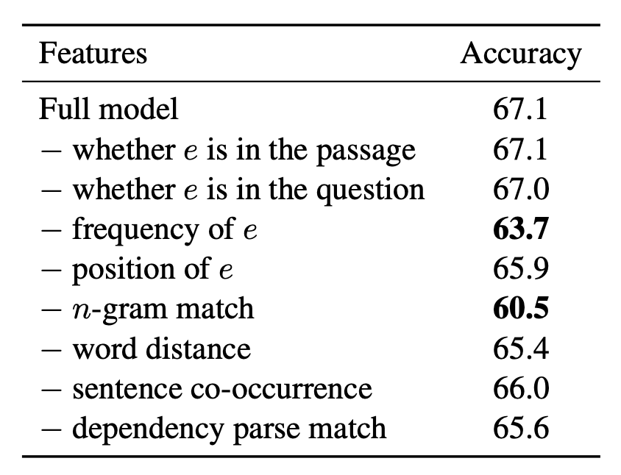
Conduct ablation studies
to ablate = to remove
If classical classifier (Naive Bayes, logistic regression), do feature ablation to see how important is each feature
If neural network with different components, ablate components.
If loss is combination of terms, ablate loss terms.
A Thorough Examination of the CNN/Daily Mail Reading Comprehension Task
https://aclanthology.org/P16-1223.pdf (Chen et al, ACL 2016, Outstanding Paper)

Slide 152
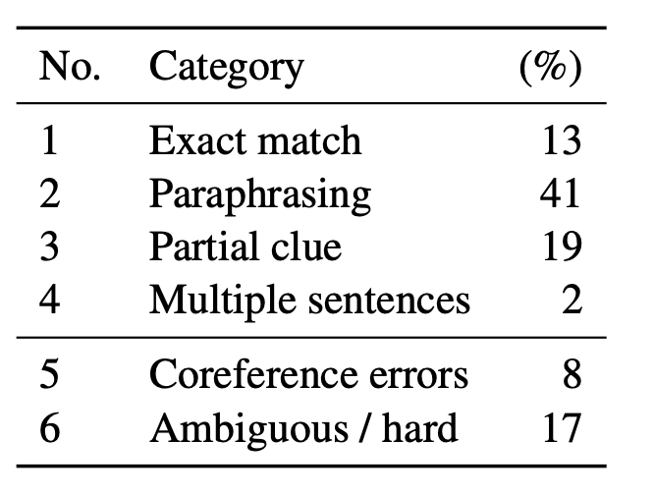
Perform data analysis
Manual analysis of 100 samples from val (dev) split
Categorize into 6 different types (based on relationship of passage/question with answer)
Answerable categories:
  Exact match
  Paragraphing
  Partial clue
  Multiple sentences
Unanswerable categories:
  Coreference error
    The dataset was automatically generated
  Ambiguous or very hard
    Humans are not likely to be able to answer these
A Thorough Examination of the CNN/Daily Mail Reading Comprehension Task
https://aclanthology.org/P16-1223.pdf (Chen et al, ACL 2016, Outstanding Paper)

Slide 153
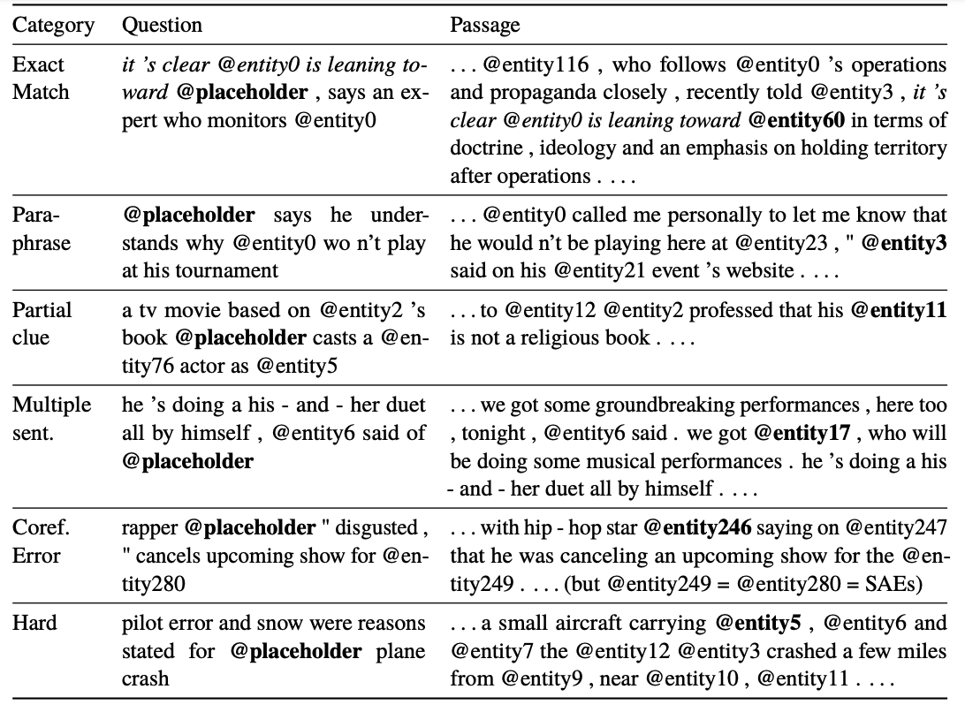
Concrete examples for each category

Slide 154
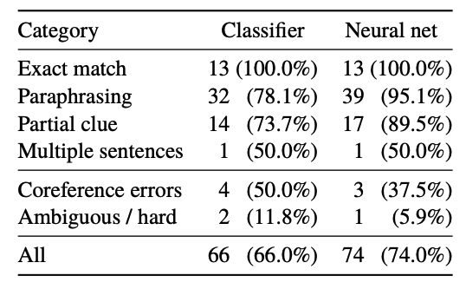
Analysis leads to insights
How many can the two models get correct for each category?
Neural network is at close to optimal performance on this dataset!

Slide 155
https://xkcd.com/1838/

Slide 156
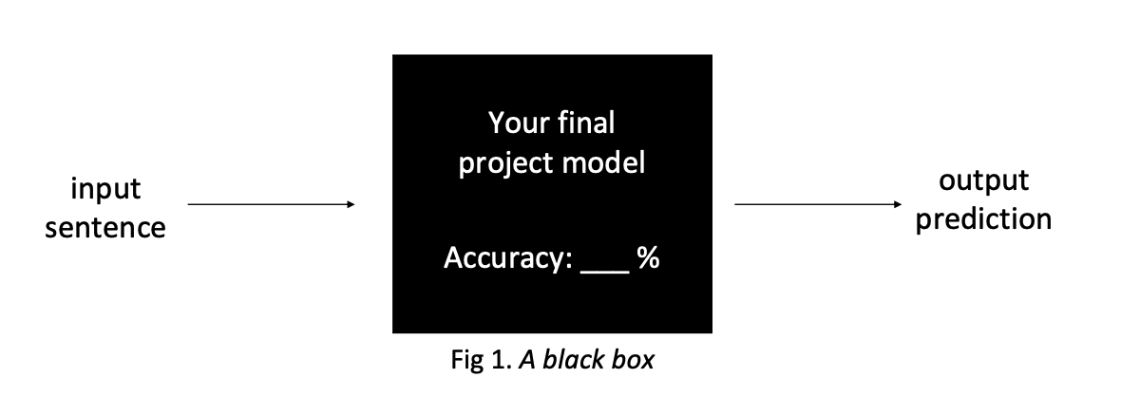
We summarize our models with one (or a handful) of accuracies metric numbers. What do they learn? Why do they succeed and fail?
Notes:
1. Finding the limits of your system
2. Understanding system behavior
3. Achieving more robust systems

Slide 157
Analyzing your results
Understanding the output of your model
  Look at the output and examine what it is getting right and what it is getting wrong
    Provide examples
  Conduct data / error analysis
  Visualize
Characterizing your model performance
  Compare against other models
  Compare against variations
    Ablation studies

Slide 158
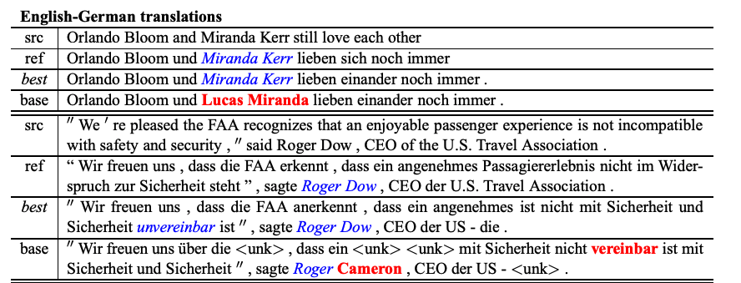
Provide qualitative examples of your model output
Simple tip: color code correct and incorrect output
Effective Approaches to Attention-based Neural Machine Translation
https://arxiv.org/pdf/1508.04025.pdf (Luong et al, 2015)

Slide 159
Conduct data and error analysis
How to perform data and error analysis?
How to start?
Take a manual subsample of the data
Manually group and categorize them (like the paper we looked at)
  You will need to figure out what these groups are!
Compute some statistics
  Overall percentage of categories
  What is the performance on each category?
Adapted from slide by Graham Neubig

Slide 160
Conduct data and error analysis
How to perform data and error analysis?
General recipe
Partition the performance of the validation set into different interpretable grouped based on pre-defined attributes.
  Define attributes
  Group test samples
  Breakdown of performance
Adapted from slide by Graham Neubig

Slide 161
  Defining attributes
Different tasks could have different attributes
Token-level, span-level, sentence-level
  Token-level: part-of-speech tag
  Span-level: span length
  Sentence-level: sentence length
Slide credit: Graham Neubig

Slide 162
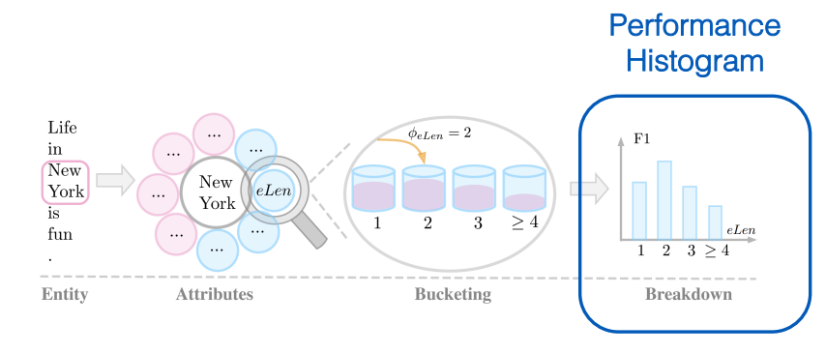
Example: breakdown performance by entity length
Slide credit: Graham Neubig

Slide 163


Performance histogram
Compare across attributes
Compare across models
Slide credit: Graham Neubig

Slide 164

Comparison of model performance by sentence length
Attribute: sentence length
Effective Approaches to Attention-based Neural Machine Translation
https://arxiv.org/pdf/1508.04025.pdf (Luong et al, 2015)

Slide 165

Integrating unit tests
Beyond Accuracy: Behavioral Testing of NLP models with CheckList
https://arxiv.org/pdf/2005.04118.pdf (Ribeiro et al, ACL 2020)
Slide credit: John Hewitt

Slide 166
Comparisons

Slide 167
Guidelines for making comparisons
Make sure you have baselines
  Random
  Majority Class
  Conditioned Majority Class
Other baselines
  Simpler version of the model vs more complex
    One layer FFNN
    Unidirectional/Single-layer RNN
  Retrieval baseline for generation problems
Always consider: is the complexity warranted?
  Different types of complexity
    Simplicity in implementation vs simplicity in concept vs simplicity in model (number of parameters)
  NN vs rule based vs NBs vs logistic regression

Slide 168
Classifier comparison
Suppose you’ve assessed two classifier models. Their performance is probably different to some degree. What can be done to establish whether these models are different in any meaningful sense?
  Practical differences
  Confidence intervals
  Wilcoxon signed-rank test (covered in the sentiment unit)
  McNemar’s test (covered in the sentiment unit)
Slide credit: Chris Potts
Notes:
https://web.stanford.edu/class/cs224u/slides/cs224u-2021-methods-part5-handout.pdf
https://www.jmlr.org/papers/volume7/demsar06a/demsar06a.pdf

Slide 169


Multiple runs with different seeds
On the stability of fine-tuning BERT: Misconceptions, explanationa, and strong baselines
https://arxiv.org/pdf/2006.04884v3.pdf (Mosbach et al, ICLR 2021)

Slide 170
Tips for training and debugging
TA Tutorial
Stanford CS231n:
  https://cs231n.github.io/neural-networks-2/
  https://cs231n.github.io/neural-networks-3/
CMU nn4nlp: Graham Neubig
  http://www.phontron.com/class/nn4nlp2021/schedule/debugging.html
  https://www.youtube.com/watch?v=KRQHdwpfj-4

Slide 171
Good luck on your project!

